Slide 1
Moving eMental Health
Best and Wise Practices from the Implementation Toolkit

Slide 2
About Me
Funding Provided by:
Mental Health Commission of Canada
Canadian Institutes of Health Research
IWK Health Centre
Projects Informing this Presentation:
Evidence Synthesis and Reviews
Implementation Toolkit
eMH Key-Informant Studies
Randomized Controlled Trials (iCBT, apps)
Design and Evaluation of Digital Interventions
Health Outcomes Scientist
(PhD Ed Tech/ Fellowship Psych)
Affiliated Scientist at the IWK Health Centre &
Maritime Patient-Oriented Research Support Unit

Slide 3
Presentation Goals
This morning I invite you to…
Learn from implementation experiences in Canada
Reflect on your own eMH action planning goals
Identify where the toolkit might address a roadblock
Promote action-focused conversations about tools needed to move eMH forward

Slide 4
Digital Discomforts
Why did we develop the toolkit?
What tools can drive eMH implementation?

Slide 5
eMental Health Services in the Canadian Context
10 provinces and 3 territories
each responsible for own mental health and addictions services
= limited federal mandate
Only 7.3 per cent of Canada’s total health spending goes to mental health. That puts Canada near the back of the pack among industrialized nations
Licensure does no carry across provincial boundaries
Canada 14th globally in Internet connectivity within the population ~ 90%

Slide 6
When rapid-evolving technologies meet entrenched routines
Why develop an implementation toolkit?
OFF THE RAILS
ON TRACK
What factors show up in eMH projects that slump?
Negative beliefs, expectations
Too much complexity, too fast
Overestimating existing infrastructure
Administrative hurdles/hoops
Lack of clarity @ purpose and value-add
Lack of knowledge about privacy/security
What factors show up in successful eMH projects?
Acceptance: Seeing the value
Appropriate: Evidence-Informed/ Evidence-Based
Engagement: Shared- decision-making + new routines
Resources: clinician time, cost, billing
Work Processes: job and task redesign
Leadership: project and change management
Vis C, Mol M, Kleiboer A, Bührmann L, Finch T, Smit J, Riper H. Improving Implementation of eMental Health for Mood Disorders in Routine Practice: Systematic Review of Barriers and Facilitating Factors. JMIR Ment Health 2018;5(1):e20
Ross J, Stevenson F, Lau R, Murray E. Factors that influence the implementation of e-health: a systematic review of systematic reviews (an update). Implement Sci 2016 Dec 26;11(1):146

Slide 7
Implementation Toolkit
Five Modules:
Exploring the world of eMH
Roadmap for launching eMH
Building your digital skillset
Engaging clients in eMH
Leadership for eMH innovation

Slide 8
Implementation Toolkit
Objectives
Content
Mini-Case Scenarios
Action Activities
Linking Resources
Preliminary Toolkit Feedback
79% (n=105) was relevant or very relevant
86% (n=106) had helped equip their organization with knowledge for establishing eMH
92% (n=94) was timely for their organization
Mental Health Commission of Canada now launching toolkit workshops

Slide 9
Digital Skills and Spaces
How do we create space for eMH?
What digital competencies do we all need to make eMH work?

Slide 10
MENTIMETER AUDIENCE POLL # 1
In what aspect is your organization MOST ready to implement eMH?
Clinician comfort level with eMH tools
Technical infrastructure (devices, connectivity)
Patient interest or demand
Organizational culture and policy mandate

Slide 11
eMH Roadmap: Readiness (you + patients + organization)
Yusif, Hafeez-Baig & Soar, 2017. e-Health readiness assessment factors and measuring tools: A systematic review. International Journal of Medical Informatics, 107, pp.56–64

Slide 12
Toolkit Scenario 1: eMH Readiness Assessment
Pockets of funding > research, surplus, demo and pilot projects, charitable donations/endowments, networks and collaborations
New funding tied to eHealth innovation
No broad eHealth (forget eMH) strategic plan or policy mandate
Lack of common language around eMH
A political history of start an stop/ fragmented momentum
Nova Scotia Health Authority and IWK Health Centre
15min survey – managers, leaders, clinicians, administrative and clerical staff
Expectations, values, comfort level, prior training, preferred training strategies, tools they currently use
Transparency- shared through geography-based town hall meetings, steering group, senior leadership meetings

Slide 13
Toolkit Scenario 2: Community Engagement
Evergreen planning: continuous updating on intervention maturity, evidence-base, public preference, equity, ROI
Best Brains Priority Project (4 Co-leads: Policy, Research, Patient Advisors & Administration)
Mental health system administrators (all levels)
Clinicians (primary care, specialized)
Patients, caregivers, family members, youth
Researchers and research focused agencies
Community (not-for profit, NGOs, etc.)
Mental Health and Addictions advocacy groups
Online portals and websites
Industry and commercial organizations

Slide 14
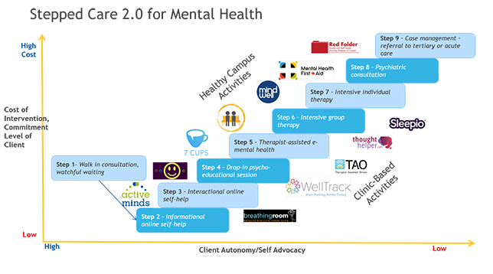
eMH Asset Mapping
What does purposeful and appropriate use of digital tools look like now? What gaps do you need to address?
@ Dr. Peter Cornish www.steppedcaretwopoint0.ca

Slide 15
Digital Planning and Advocacy
Where to find support for implementation?
How do you launch a new eMental health service?
?

Slide 16
MENTIMETER AUDIENCE POLL # 2
Which implementation phase is your organization best prepared for?
Readiness/Prelaunch
Going live/Rollout
Post-Launch/Evaluation/Sustaining

Slide 17
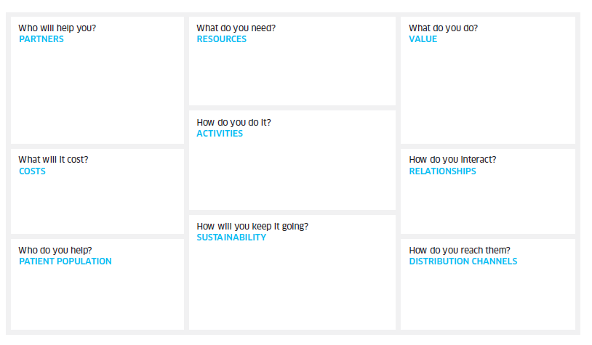
Implementation Planning Canvas
Work through proposed implementation projects systematically
Strengths-based planning
Community engagement
Communicating value
Narrow Problem Focus

Slide 18
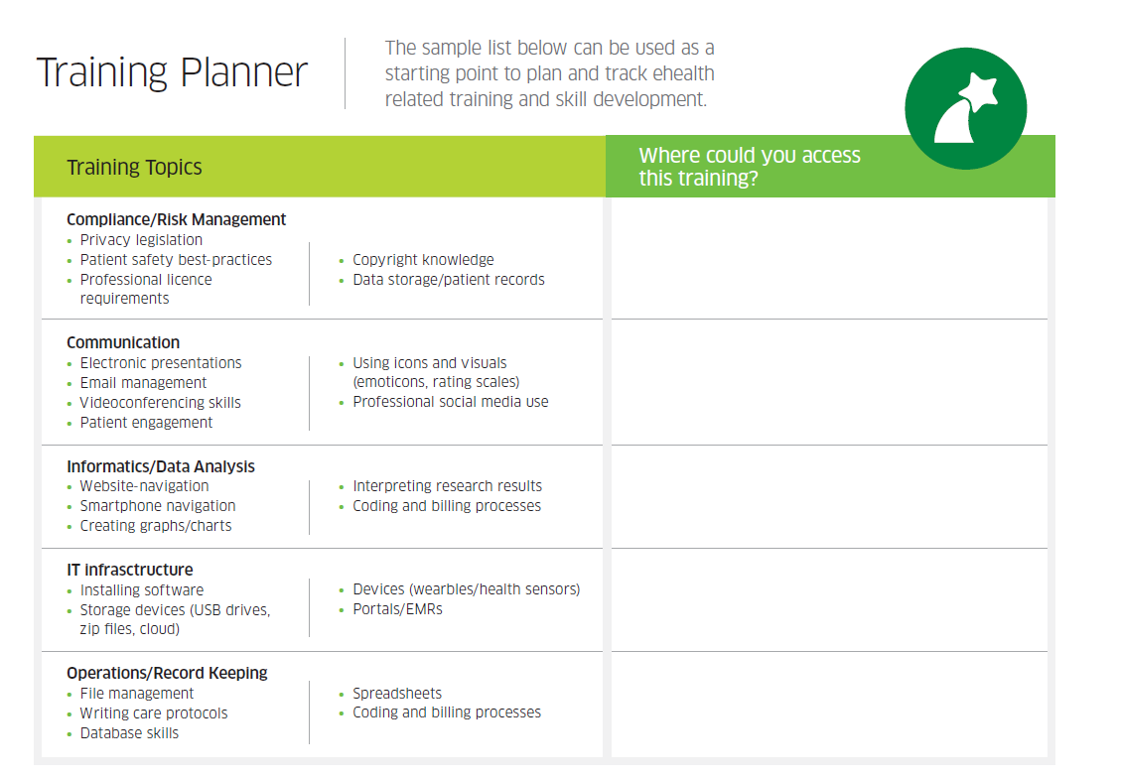
Toolkit Scenario 3: Professional Development for eMH
The deployment of e-mental health technology has outstripped discussions around the skills and competencies
College of Family Physicians Canada +
Centre for Research in Family Health
Physicians “eprescribing” behavioural health apps (mild-moderate) insomnia, deprescribing sleep medication, anxiety, depression, caregivers of persons
with dementia
Non-specialist mental health care providers need guidance about WHEN eMH tools are appropriate
Initiating eMH conversations, basics on privacy and safety, evidence-based online resources

Slide 19
Community of Practice –Normalizing eMH
Building an eMH community of practice from novice to expert
Community-based adult education programs
Online courses and webinars
Private tutor or teacher
Reverse mentoring
Seminars and workshops
Evidence-based publications
Conference and professional associations

Slide 20
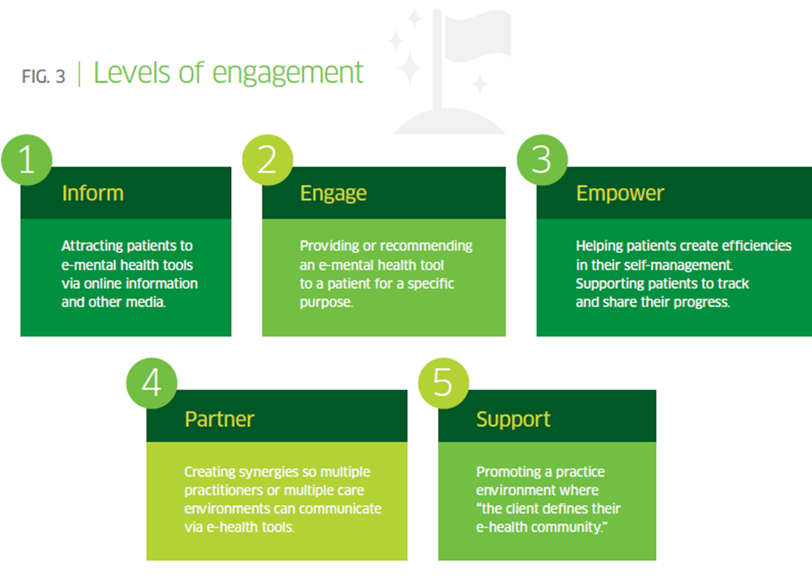
Leading Implementation Projects
Making eMH Policy Visible
A compelling and realistic vision (public + organizational)
Challenge outdated assumptions
Give credit where it is due
Policy experimentation
Accountability and mandate
*Coming Soon
eMH FAQS for Leaders
Practice- focused case scenarios

Slide 21
The Future
If we were to build an Implementation Toolkit 2.0 where would it take us?

Slide 22
Future Directions and Implementation Conversations
Power and Vulnerability
Professional Identity
Sense of Connection

Slide 23
Thank You
Lori Wozney
+902-471-5463
Lori.Wozney@nshealth.ca
Nova Scotia Health Authority
Mental Health and Addictions
Policy and Planning
LinkedIn

Slide 24
Resources
Mental Health Commission of Canada- eMH Implementation Toolkit
Implementation of eMental Health care: viewpoints from key informants from organizations and agencies with eHealth mandates
Pediatric eMental healthcare technologies: a systematic review of implementation foci in research studies, and government and organizational documents

