Slide 1
E-mental health at the university - student panel – Felix Bolinski

Slide 2
E-Mental Health @VU
Research
Education

Slide 3
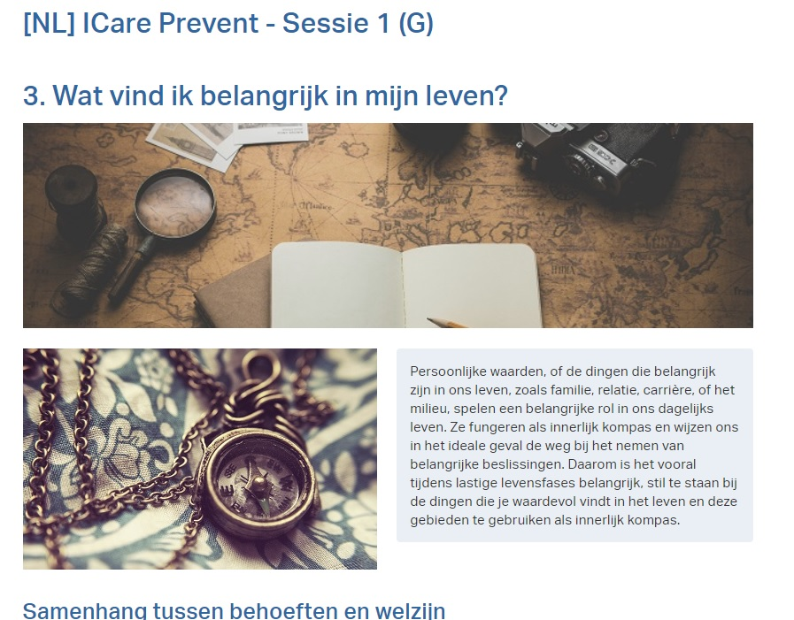
Research
Prevention and treatment of depression and anxiety among college students

Slide 4
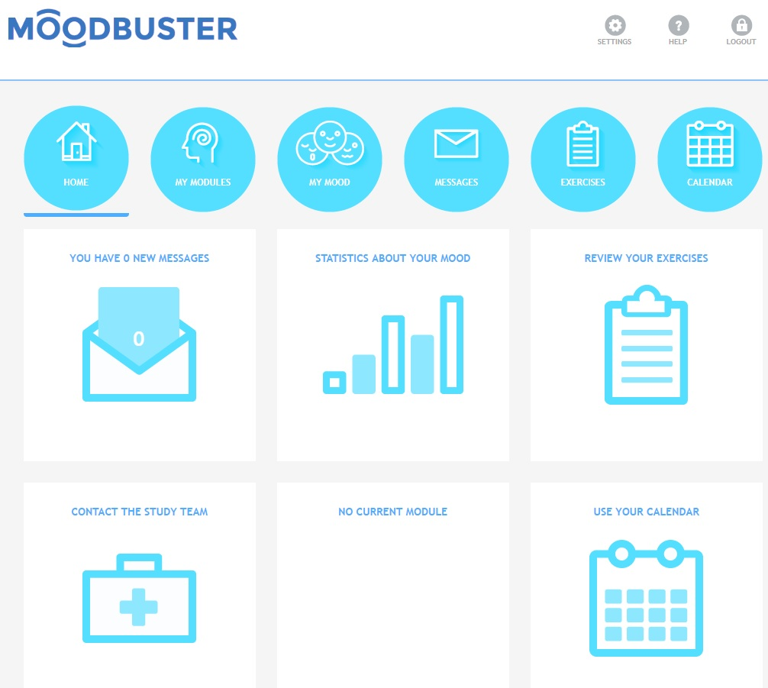
Education
Course: ‘E-Mental Health – Research and Practice’
Training eCoaches using Moodbuster

Slide 5
Student panel
Let’s make it work!

Slide 6
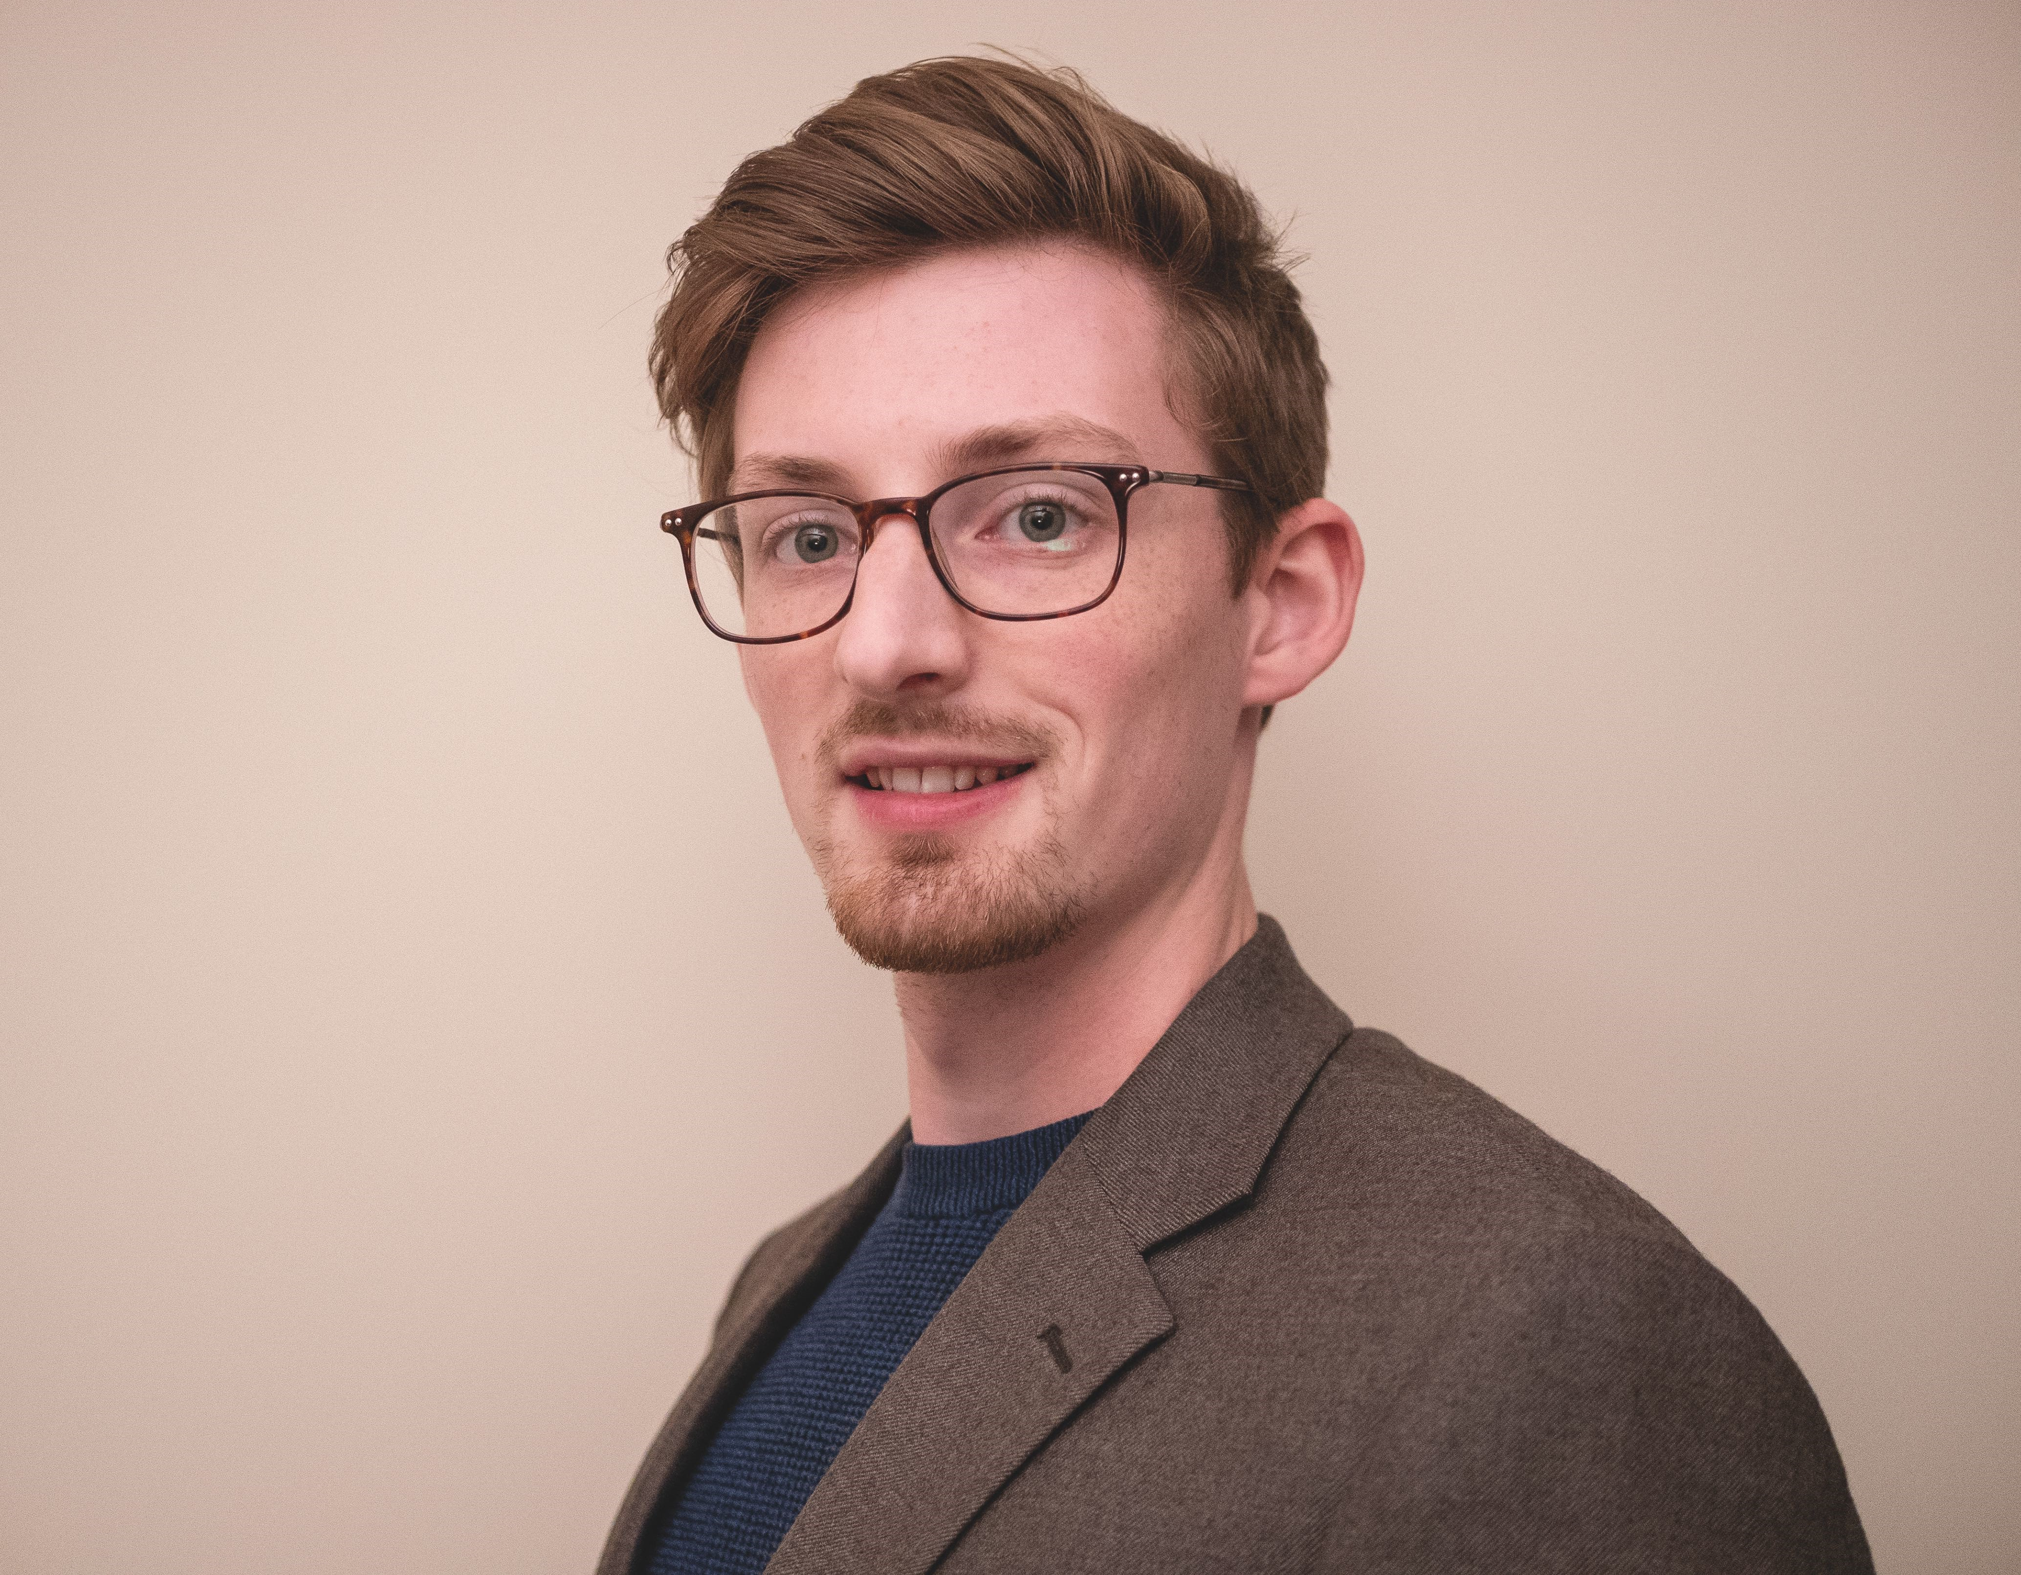
Ben Townsend, University of East Anglia
James Mason, University of East Anglia
Niklas Strüwe, Vrije Universiteit Amsterdam
Nicky Stouwdam, Vrije Universiteit Amsterdam
Felix Bolinski, Vrije Universiteit Amsterdam

Slide 7
Introduction
What is your experience with E-Mental Health?

Slide 8
Advantages & things to take into account

Slide 9
Next steps

Slide 10
General discussion
What do you think? Time to get the audience involved!

Slide 11
What do you think?
Go to menti.com

Slide 12
Thanks!
Any questions?
Ask us personally or send your inquiry to:
f.bolinski@vu.nl

