Slide 2
Site Emissions Tool
Estimating GHG emission after rewetting
Jasper van Belle and Valentina Sechi
Care-Peat partner meeting February 4-5

Slide 3
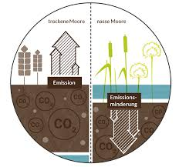
SET:
user-friendly interface to estimates GHG-reduction after rewetting of drained peatlands
Supporting decision making
Basis for financial compensation of rewetting based on GHG emission reduction

Slide 4
Approach
SET estimates
Emisson in a baseline scenario
Emission in a post-rewetting scenario
Difference in the net GHG-emission between the 2 scenarios

Slide 5
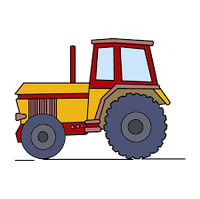
Approach
SET
Based on existing information on groundwater level, vegetation, fertilizing practices and feedstock intensity
Considers emission from
      fertilizer application and crop residues
      soil
      fossil fuel use

Slide 6
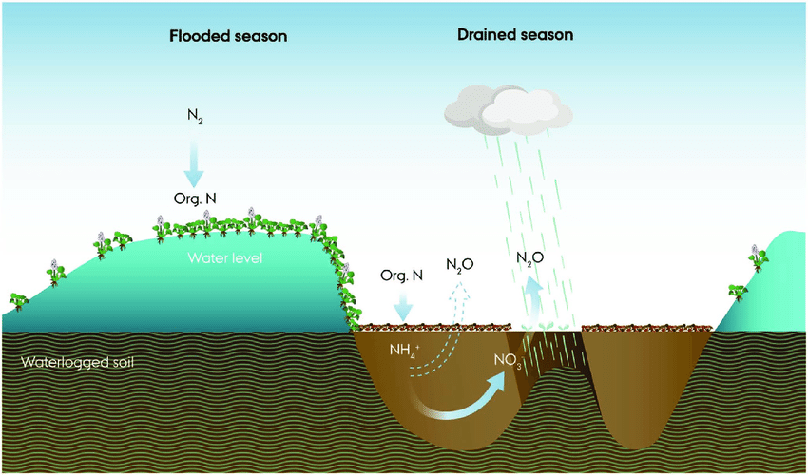
1. GHG from soils
GEST is database of vegetation types and associated emission measurements (Couwenberg et al. 2009, 2011);
GEST assumes:
groundwater level + vegetation = CO₂ + CH₄ emissions.

Slide 7

2. GHG from fertilizer and
crop residues
Direct emissions resulting from fertilization;
Indirect emissions resulting from leaching to water and air;
Calculated using IPCC Tier 1 calculations (De Klein et al. 2006).
Notes:
The Intergovernmental Panel on Climate Change was created to provide policymakers with regular scientific assessments on climate change, its implications and potential future risks, as well as to put forward adaptation and mitigation options

Slide 8
3. GHG from fossil fuel use
Results from land management and water management: tractors & pumps
Diesel consumption;
Electricity use.

Slide 9
How does SET look like?

Slide 10
Input screen (1/2)
Peat thickness determines time horizon of GHG-benefits of rewetting
Filling in groundwater level determines moisture class;
This limits vegetation class options;
User selects best fitting vegetation with this groundwater level

Slide 11
Input screen (2/2)
Rewetting can increase fuel consumption
Product use with long life is treated as C-capture

Slide 12
Output screen (1/3)

Slide 13
Output screen (2/3)

Slide 14
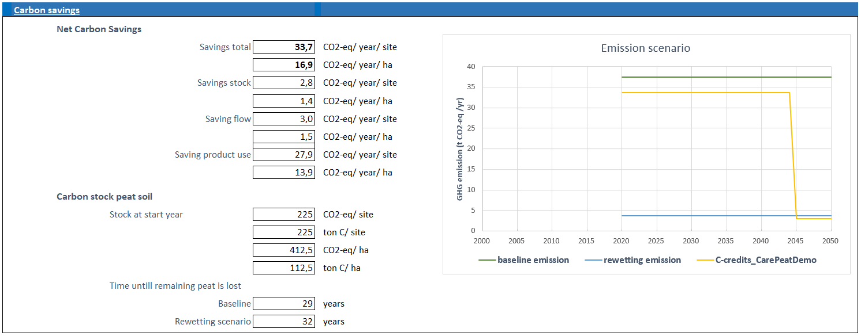
Output screen (3/3)

Slide 15
Why am I here?
…to share and create synergies between Care-Peat and Cconnect
SET we need to:
Calibrate and test our tool with real data
Test with different environmental condition

Slide 17
How to
working with GEST

Slide 18

Carbon flows in soil
CO2 in from air and incoming surface water
CO2 out from plant and soil resp, and outgoing surface water
Water level affects breakdown of CH₄ to CO₂
‘shunt’ plants transport CH₄ from water logged soil directly to air
(chimney effect)
Rydin & Jeglum 2013

Slide 19
GEST – Using vegetation as a proxy
Vegetation is
Easy to monitor
Strongly related to groundwater level
… and to other factors relevant for GHG emissions (soil P, N, pH…)
And affects soil processes directly and indirectly
Groundwater level (cm above surface)
Vegetation type
Hennekens et al. 2010

Slide 20
Working with GEST – moisture classes
Mean water level – wet season
Determine groundwater level
Determine moisture class
Mean water level – dry season
Soil moisture class (GEST) |  | Water tables in relation to surface (+ above, - below)
 |  | WLw | WLd
7+ | Upper sublitoral | +250 to +140 cm | +250 to +140 cm
6+ | Flooded (lower eulittoral) | +150 to +10 cm | +140 to +0 cm
5+ | Wet (upper eulittoral) | + 10 to – 5 cm | +0 to -10 cm
4+ | Semi wet (very moist) | -5 -to -15 cm | -10 to -20 cm
3+ | moist | -15 to -35 cm | -20 to -45 cm
2+ | Moderate moist | -35 to -70 cm | -45 to -85 cm
2- | Moderate dry | < 60 l / m²
3- | Dry | 60 – 100 l / m²
4- | Very dry | 100 – 140 l / m²
5- | Extremely dry | >140 l / m²
Dealing with fluctuations:
5+/4+ = WLw 5+ with WLd 4+
3~ = WLw 4+ and WLd 2+
Water deficit: only for (too) dry types

Slide 21
Working with GEST – selecting GESTs
methane emission
Combined GWP
excluding N₂O
Nr. of studies used
Determine groundwater level
Determine moisture class = 4+
Determine relevant GHG Emission Site Type
CO₂ emission
N° | GEST | Soil Moisture Classes | CH4 (tonnes CO₂-eq/ha/yr) |  | CO2 (tonnes/ha/yr) |  | Total C-flux (tonnes CO2-eq/ha/yr)
 |  |  | GWP | n | GWP | n | GWP
 | Grassland
G1 | Dry to moderately moist grassland | (2~), 2+, 2- | -0.01 | 24 | 31.44 | 16 | 31.5
G2 | Moist grassland | 3+, 3+/2+ | 0.01 | 48 | 19.37 | 38 | 19.5
G3 | Moist to very moist grassland | 4+/3+ | 0.03 | 3 | 13.46 | 4 | 13.5
G3f | Periodically flooded grasslands | 4~, 3~ | -0.05 | 3 | 13.46 | - | 13
G3s | Moist to very moist grassland with shunt species | 4+/3+, 3~, (3+, 3+/2+) | 0.75 | 7 | 13.46 | - | 14
G3m | Moist to very moist acidic Molinia meadows | 4+/3+ | 4.85 | 6 | 6.45 | - | 11.5
G4 | Very moist grassland | 4+, 4~ | 0.39 | 7 | 6.45 | 3 | 7
G4s | Very moist grassland with shunt species | 4+ | 2.1 | 4 | 6.45 | - | 8.5
G5 | Wet grassland | 5+/4+ | 0.05 | 3 | -3.89 | 5 | -4
G5s | Wet grassland with shunt species | 5+, 5+/4+, (4~) | 2.93 | 4 | -3.89 | - | -1
 | Cropland

Slide 22
Working with GEST – select best match
N° | GEST | Soil Moisture Classes | CH4 (tonnes CO₂-eq/ha/yr) | CO2 (tonnes/ha/yr) | Total C-flux (tonnes CO2-eq/ha/yr)
 |  |  | GWP | GWP | GWP
 | Grassland
G3 | Moist to very moist grassland | 4+/3+ | 0.03 | 13.46 | 13.5
G3f | Periodically flooded grasslands | 4~, 3~ | -0.05 | 13.46 | 13
G3s | Moist to very moist grassland with shunt species | 4+/3+, 3~, (3+, 3+/2+) | 0.75 | 13.46 | 14
G3m | Moist to very moist acidic Molinia meadows | 4+/3+ | 4.85 | 6.45 | 11.5
G4 | Very moist grassland | 4+, 4~ | 0.39 | 6.45 | 7
G4s | Very moist grassland with shunt species | 4+ | 2.1 | 6.45 | 8.5
G5 | Wet grassland | 5+/4+ | 0.05 | -3.89 | -4
G5s | Wet grassland with shunt species | 5+, 5+/4+, (4~) | 2.93 | -3.89 | -1
 | Unmanaged
U6 | Very moist bog heath | (5+/4+), 4+ | 0.92 | 4.67 | 5.5
U7 | Very moist forbs and sedges | (5+/4+), 4+, (4+/3+) | 0.25 | 12.56 | 13
U8 | Very moist Sphagnum lawn | (5+/4+), 4+ | 1.5 | -4.3 | -3
U9 | Very moist tall sedges | (5+/4+), 4~, 4+, (4+/3+) | 1.6 | 10.72 | 12.5
U10 | Wet bare peat | 5+/4+ | 0.22 | 1.34 | 1.5
U12 | Wet small sedges with mosses | 5+ (4+) | 4.72 | -1.99 | 2.5
U13 | Wet sphagnum lawn | 5+, (5+/4+) | 5.25 | -3.02 | 2
U14 | Wet tall reeds | (5~), 5+, (5+/4+) | 6.47 | 0.21 | 6.5
U15 | Wet tall sedges | 5~, 5+, (5+/4+) | 9.49 | 1.03 | 10.5
U16 | Wet bog heath | 6+/5+, 5+, (5+/4+) | 17.8 | -0.01 | 18
 | Special GESTs
S4 | Grassland (2+/3+) flooded in summer (wet year) | (5+), 5+/4+, (4+) | 26.02 | -0.13 | 26
S5 | Simulated harvest (Paludiculture) | (5+), 5+/4+ | 3.08 | 11.46 | 14.5
S6 | Wet tall reeds (dry year) | (5+/4+), 4~, 4+ | 0.79 | 10.72 | 11.5
S7 | Sphagnum lawn at former peat cut areas | 5+, 5+/4+ | 37.27 | 2.83 | 40

