Slide 1
The Community Hydrogen Forum and Decision Support Tool
Dr Rory Monaghan, NUI Galway
Monday, 21st October 2019
Dublin City University

Slide 2
Overview
GenComm Deliverables
The Hydrogen Opportunity for Communities
The Community Hydrogen Forum
The CH2F Decision Support Tool
The Next Steps

Slide 3
GenComm Deliverables Community Hydrogen Forum & Decision Support Tool
Decision Support Tool
Curtailed renewable energy sources
Hydrogen could make sense for my community, organisation or company.
But how do I make it happen?
How do I find a hydrogen source or market?
Energy demands
Where can I learn about hydrogen opportunities?
How do I take the next steps?
How do I connect with others across Europe?
Industry
Wind Energy
Mobility
Solar Energy
AD Plant
Stationary Energy

Slide 4
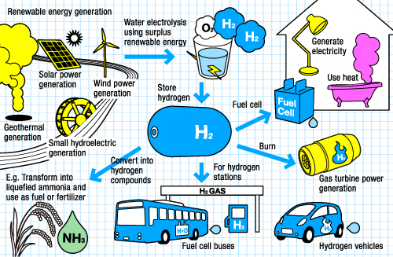
The Hydrogen Opportunity for Communities
Energy security
Reliable emissions free transport, heat and power
Long-term energy storage
Reduced fossil fuel use
Local investment
New clean industries
Hi-tech employment
Community development
http://www.thinktheearth.net/thinkdaily/report/2010/08/rpt-53.html#page-2
How can communities recognise and take the H₂ opportunity?

Slide 5
The Community Hydrogen Forum Overview
Platform designed to help everyone understand the opportunities hydrogen technologies offer, especially in Northwest Europe.
Intended to be a forum for national, regional, and local governments, energy agencies, community development groups, energy cooperatives, educational institutions, renewable energy developers, transport sectors, and grid operators.
Any stakeholder from Ireland, UK, France, Belgium, Netherlands, Luxembourg, and Germany is encouraged to participate as a member.
http://communityh2.eu/

Slide 6
The Community Hydrogen Forum Objectives
To raise awareness of the potential of hydrogen in sustainable community development, decarbonisation, and energy security.
To offer a forum to share information, experience and best practice of how communities and projects are deploying hydrogen across north west Europe.
To provide an up-to-date, informed resource for hydrogen information.
To provide access to a unique Decision Support Tool (DST) to assist in evaluating how hydrogen technologies can be deployed in individual scenarios.
To play a role in developing long term strategies for the advancement in adoption of hydrogen technologies.
http://communityh2.eu/

Slide 7
The Community Hydrogen Forum A tour of the website
http://communityh2.eu/

Slide 8
The Decision Support Tool What is it?
Supports NWE stakeholders to evaluate the potential of hydrogen in:
sustainable community development
Decarbonisation
energy security
Achieves this by demonstrating the role of hydrogen produced at onshore wind farms in decarbonising public bus fleets in large cities across the region
Will later be expanded to include solar and bioenergy
Visualised in an online interactive map of NWE

Slide 9
The Decision Support Tool Why city buses?
Hydrogen fuel cell city buses are now on sale commercially
They provide a large, predictable, centralised hydrogen demand
Fuel cell buses or fleets operate in or are ordered for Aberdeen, London, Seoul, Tokyo, and many other cities
CaetanoBus H2.City Gold bus (right) launched last week with 400-km range and 9-minute refuel time
https://www.electrive.com/2019/10/19/caetanobus-launches-fc-bus-with-toyota-system/

Slide 10
The Decision Support Tool How it works
Annual energy demands for big city bus fleets
Hydrogen energy equivalent
Total hydrogen demand
Big city locations
Hydrogen supply chain
Wind farm locations
37 cities across North West Europe
4,252 wind farms across North West Europe
Total hydrogen supply
Optimal electrolyser size at every wind farm
Optimal electrolyser size at every wind farm
Available curtailed wind at every wind farm
“Top up” power needed from grid for 24/7 operation

Slide 11
The Decision Support Tool How it works
Input from users
wind curtailment, $\text{E}\text{DD}$ (%)
capacity factor, $\text{CF}\text{WF}$ (%)
wind farm capacity, $\text{CP}\text{WF}$ (MW)
Wind curtailment volume (MWh)
Techno-economic parameters
Technical model
Hydrogen production (kg/y)
Optimum electrolyser size (MW)
Required water (kg/y)
Required electricity from the grid (MWh)
Economic model
Transport model
CAPEX ($€$)
Fixed OPEX ($€$)
Variable OPEX ($€$)
Travel cost ($€$)
Location & routes by GIS
Operating cost relative to diesel (excl. transport)
Full operating cost relative to diesel

Slide 12
The Decision Support Tool Results for Dublin
http://communityh2.eu/dst/

Slide 13
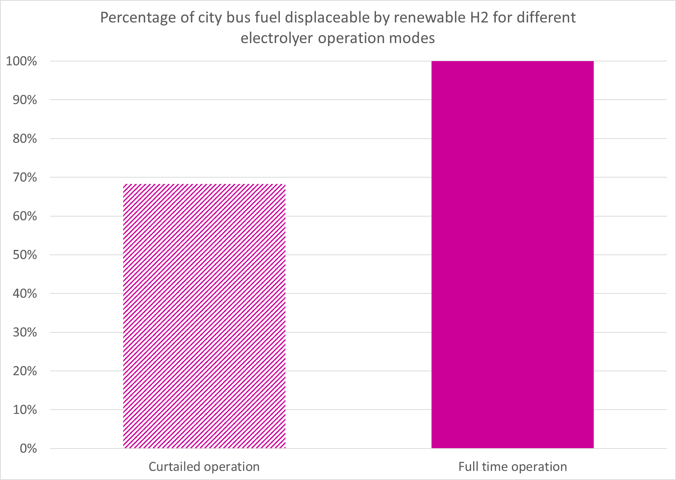
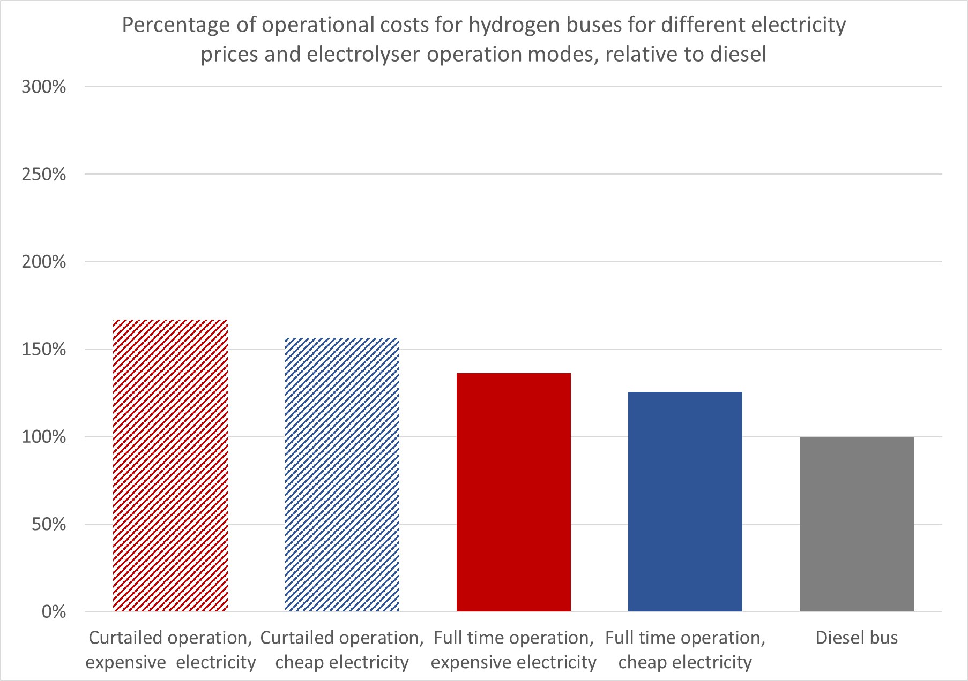
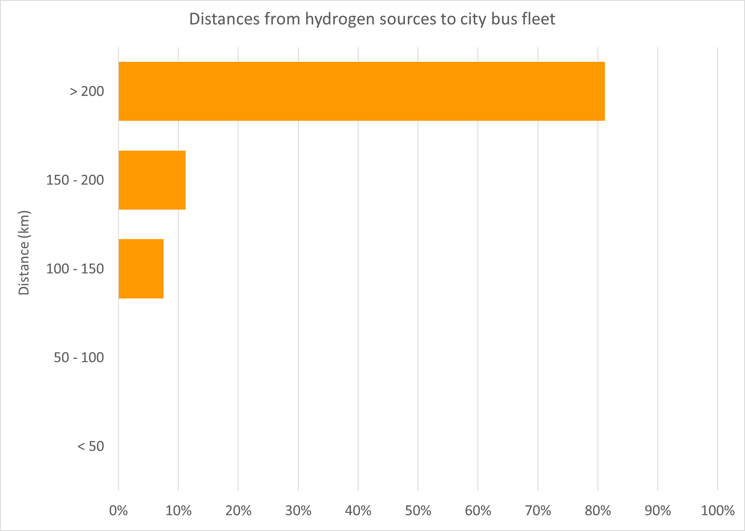
The Decision Support Tool Results for Dublin
The hydrogen opportunity is here.
Will your community explore it?
Hydrogen would displace 70% of Dublin bus fleet fuel use with curtailed operation of the electrolyser, or 100% with full time operation
A Dublin fuel cell bus could operate with costs from 26% higher than diesel (full time electrolyser operation, cheap electricity) to 67% higher (curtailed operation, expensive electricity)
Over 80% of the hydrogen available to fuel the Dublin bus fleet must be transported over 200 km (from the west coast) but the wind resource makes it worthwhile

Slide 14
The Next Steps For the DST
Projections of future costs
Addition of solar and bioenergy
Addition of other use cases
Publication of findings

Slide 15
The Next Steps For potential hydrogen stakeholders
Go to http://communityh2.eu/ and register to join the Community Hydrogen Forum
Learn about the exciting community hydrogen projects underway across North West Europe
Explore your region’s hydrogen potential using the DST
Contact the Community Hydrogen Forum at info@communityh2.eu to start taking the next steps to realise your community’s hydrogen opportunity

Slide 16
Backup slides

Slide 17
Tour backup slides About us
http://communityh2.eu/about-us/

Slide 18
Tour backup slides Hydrogen insights
http://communityh2.eu/h2-insights/

Slide 19
Tour backup slides Links
http://communityh2.eu/

Slide 20
Tour backup slides Links – National hydrogen associations
http://communityh2.eu/links/

Slide 21
Tour backup slides Links – Some key EU projects
http://communityh2.eu/links/

Slide 22
Tour backup slides Links – GenComm partners
http://communityh2.eu/links/

Slide 23
Tour backup slides Hydrogen discussion forum
http://communityh2.eu/community/

Slide 24
Tour backup slides Decision Support Tool
http://communityh2.eu/dst/

