Slide 1


Introduction to the Enabling Support Tool
Tadgh Cummins
Tim Williamson
Place image in this area.

Slide 2


We need to speak to the End Users, those whose jobs it is to decarbonise and strengthen energy security.
We cannot promote “hydrogen for the sake of hydrogen”. We must find the right roles.
Industry-Research collaborations are essential for enabling clear-headed, objective decision-making

Slide 3
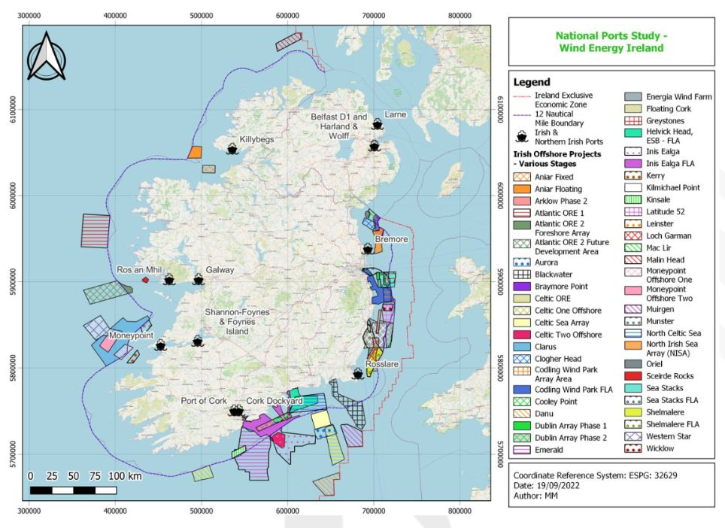
Europe’s H2 potential is immense
H2 demand exists in some countries
Green H2 production potential exists in others
Its deployment will go hand in hand with renewables
Common question: “How much will green H2 cost?”

Slide 4
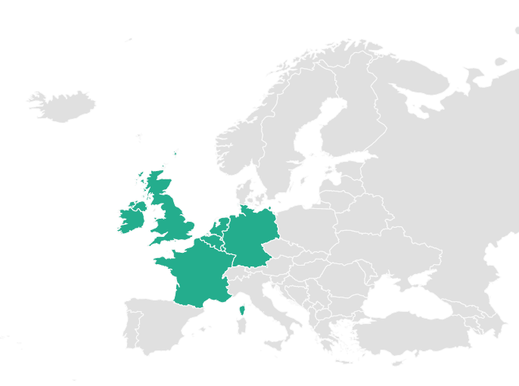
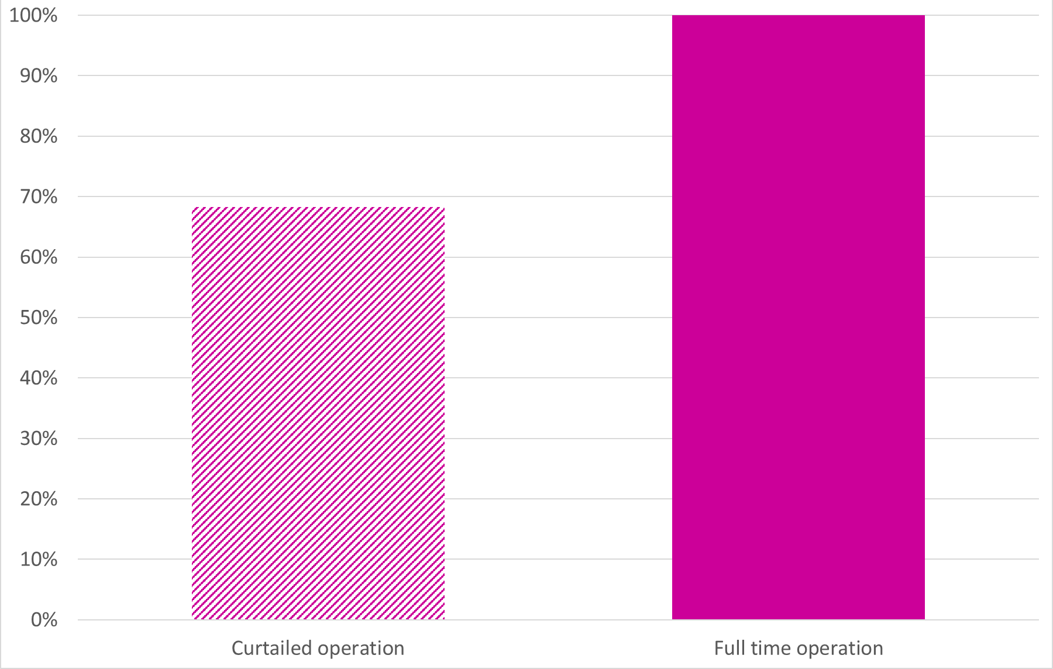
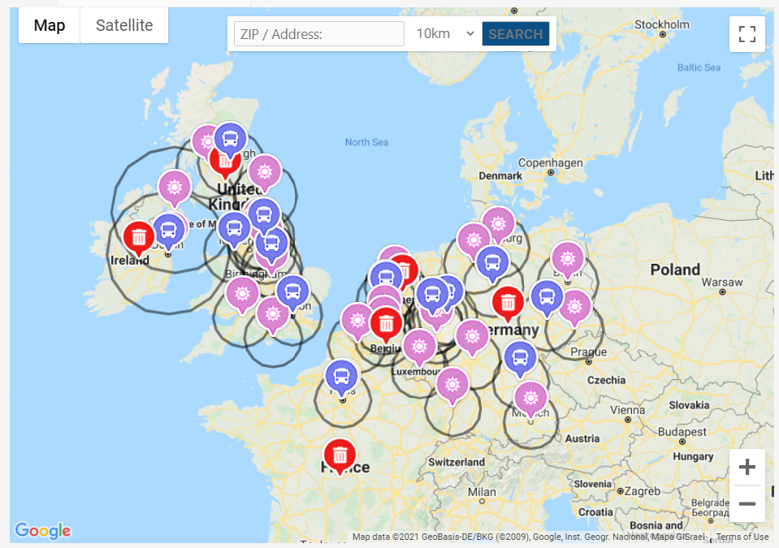
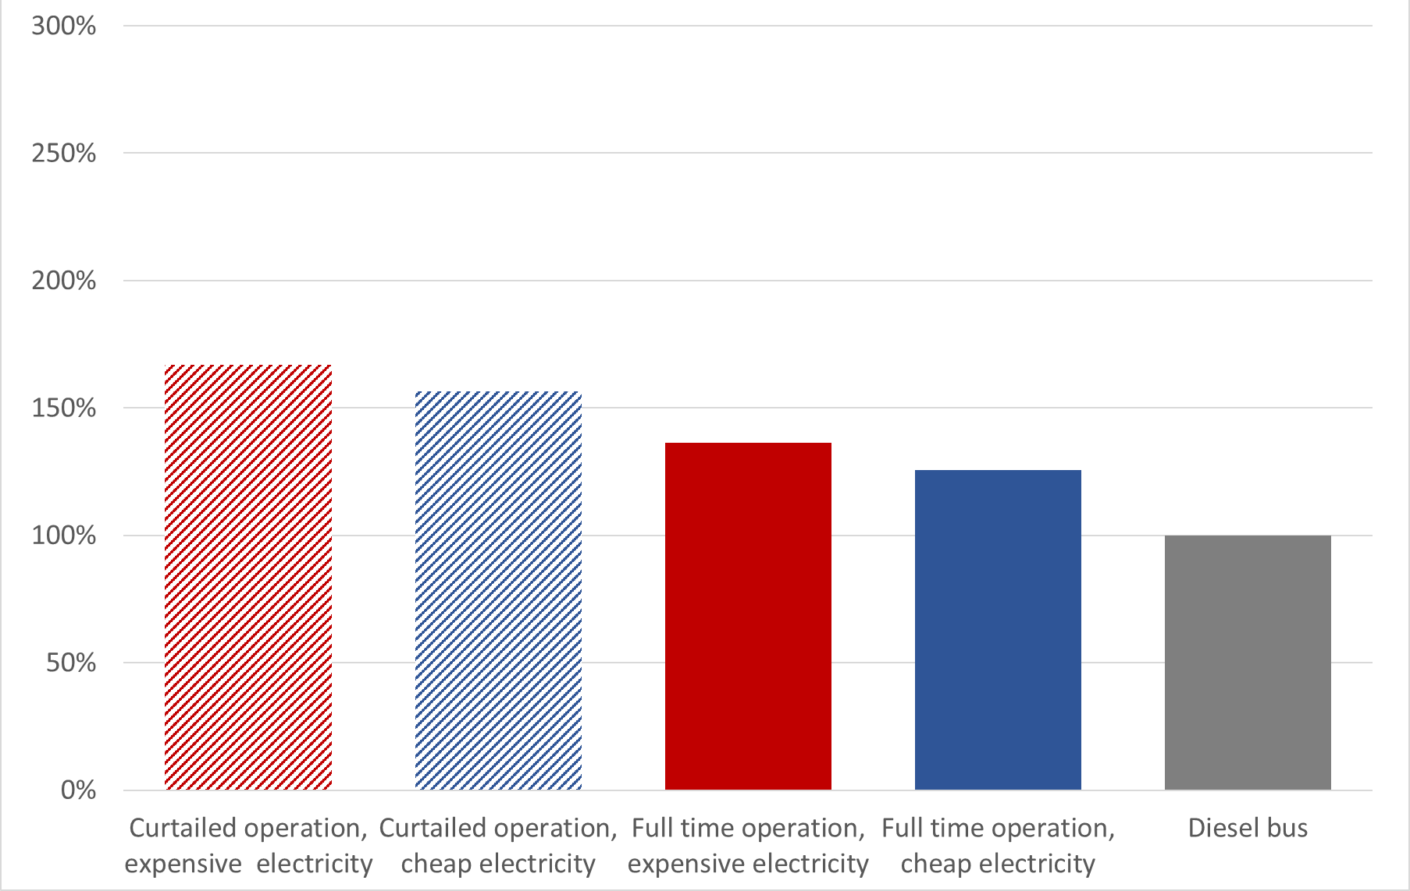
GenComm’s Decision Support Tool
Aimed to inform on quantities, costs, fossil fuel displacement for onshore green H2
Percentage of Dublin city bus fuel displaceable by H2 for different electrolyser operation modes
http://communityh2.eu/dst-simple/
http://communityh2.eu/dst/
Hydrogen costs for different electricity prices and electrolyser operation modes, relative to diesel for Dublin

Slide 5
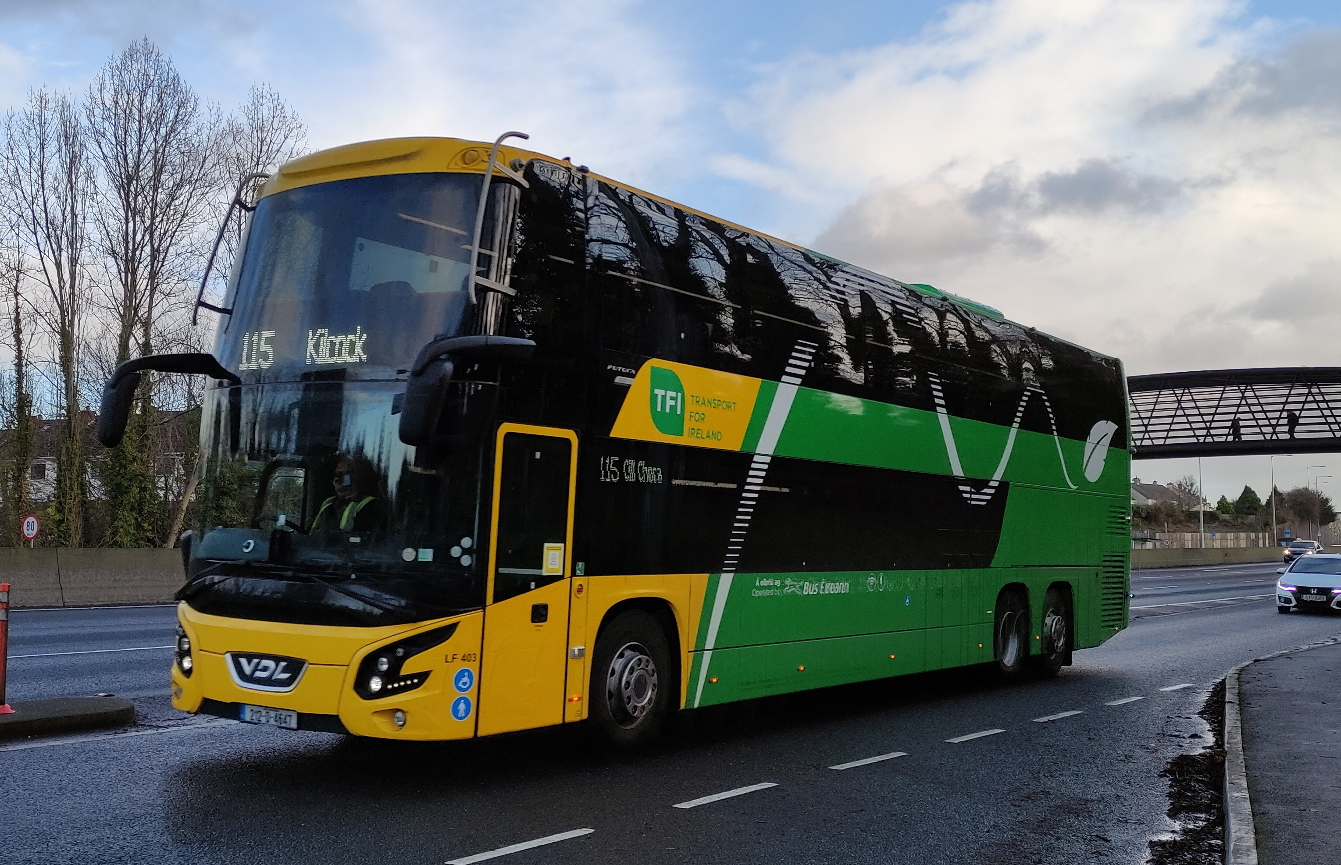
What about the End User?
The Enabling Support Tool
Focus is now on specific sectors that:
Will struggle to be fully electrified
Have H2 technology close to or at commercial reality
We need to communicate to potential end-users in terms they understand
Cost effective decarbonization and energy security are the drivers, not finding a use for green H2!
Total Cost of Ownership (TCO) is how bus fleet operators VALIDATE decarbonization performance

Slide 6
What does the EST do?
Enables bus fleet operators to plan best fleet decarbonization mix
Assumes first decarbonization approach will be battery electrification
Portion of routes in a network unsuited* to battery electrification are identified
* Due to HVAC loads, utilization rates, passenger & battery weight, steep gradients
The EST calculates Total Cost of Ownership of different decarbonization options

Slide 7
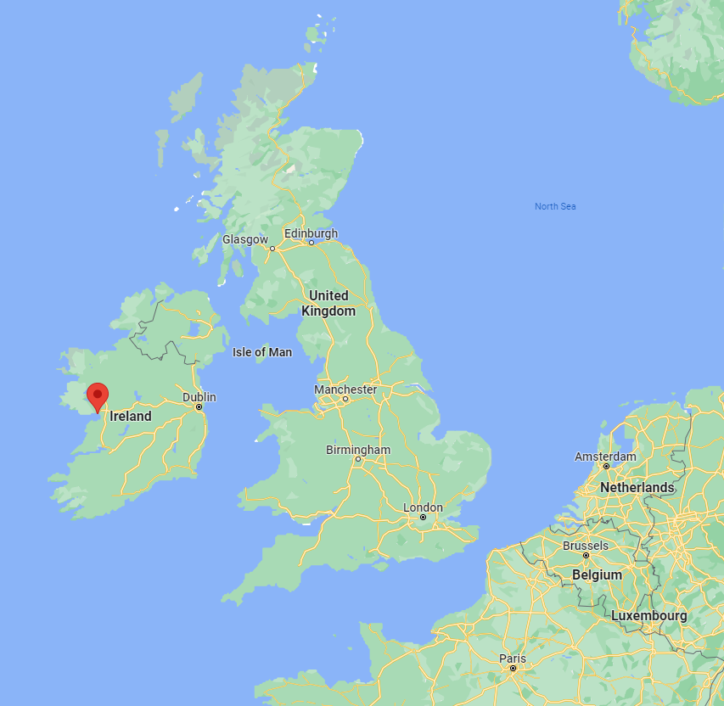
Decarbonizing a single bus route in Galway
Diesel
TCO drops as a bus is used more effectively
Diesel

Slide 8
Decarbonizing a single bus route in Galway
Calculated battery maximum km/day
Battery TCO drops quickly until…
Battery
Diesel
TCO drops as a bus is used more effectively
Diesel

Slide 9
Decarbonizing a single bus route in Galway
Calculated battery maximum km/day
Battery TCO drops quickly until…
Higher km/day needs more buses
Battery
Diesel
Battery
Diesel

Slide 10
Decarbonizing a single bus route in Galway
Calculated battery maximum km/day
Hydrogen
Battery
Diesel
Battery
Diesel
Battery is cost effective at lower km/day
Hydrogen is cost effective at higher km/day
Hydrogen

Slide 11
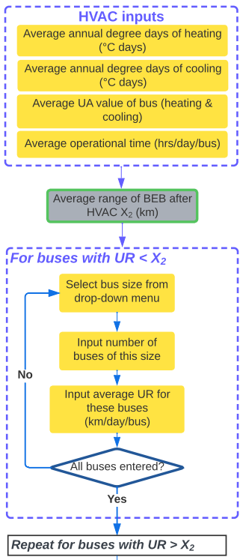
Techno-Economic Model
Select Location
Currently models four fleet types:
  Internal combustion engine bus (ICEB)
  Battery Electric Bus (BEB)
  Fuel Cell Electric Bus (FCEB)
  Mixed fleet of BEBs & FCEBs
And three bus sizes:
  Single-Deck
  Double-Deck
  Articulated
#1 Rule: Buses in new fleet must match existing buses in size and range
Input process designed to divide the bus fleet into a mixed fleet considering regional weather conditions, road topology and bus weight

Slide 12
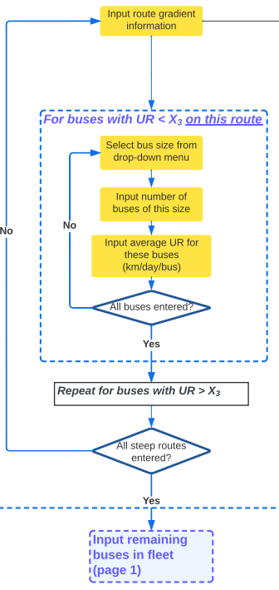
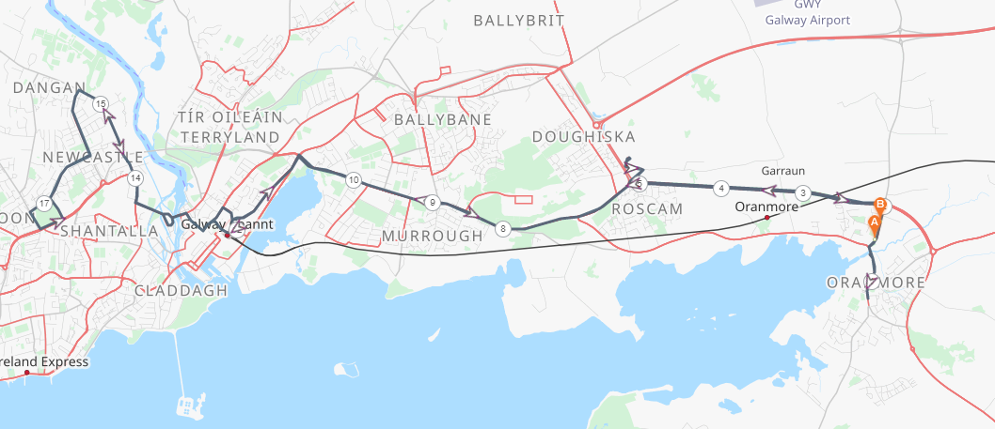
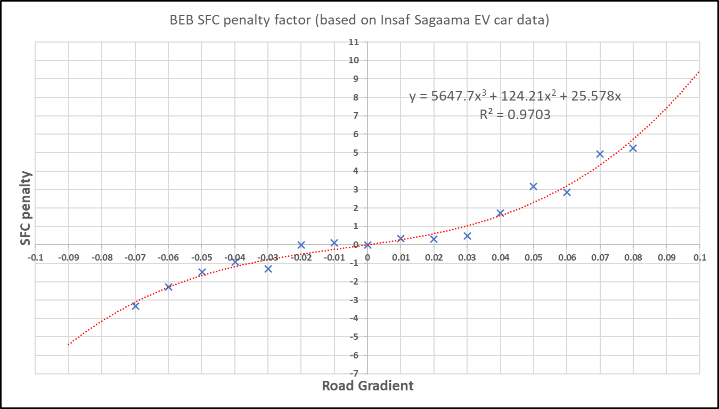
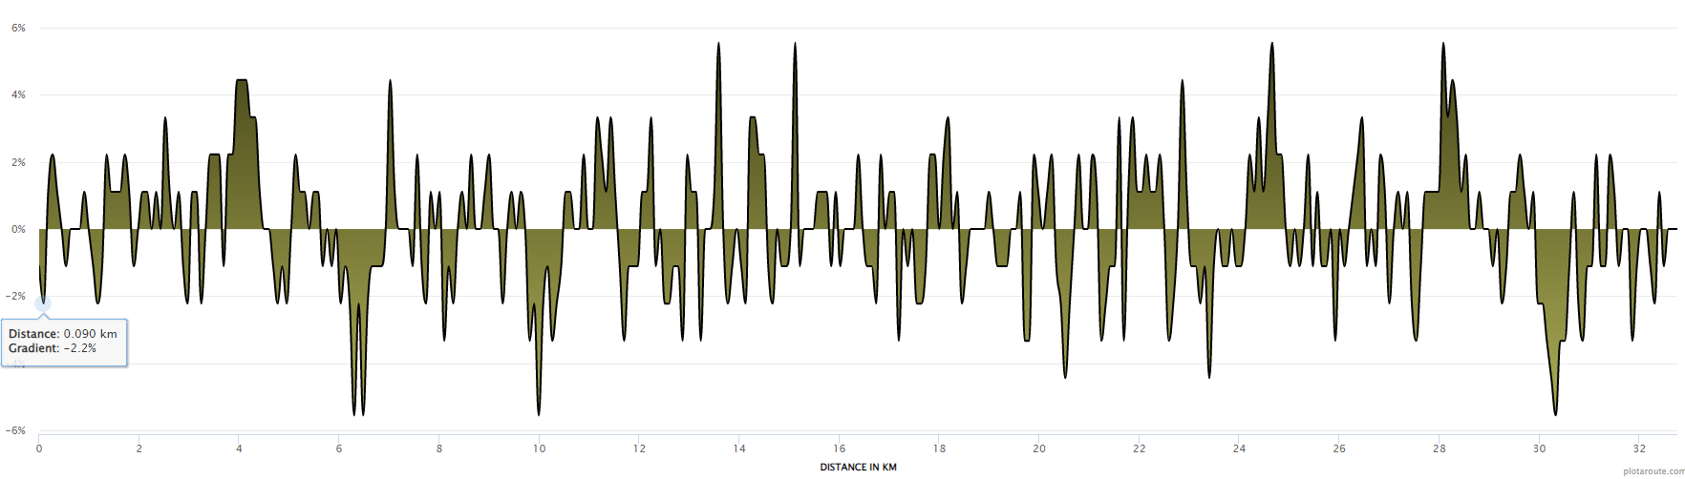
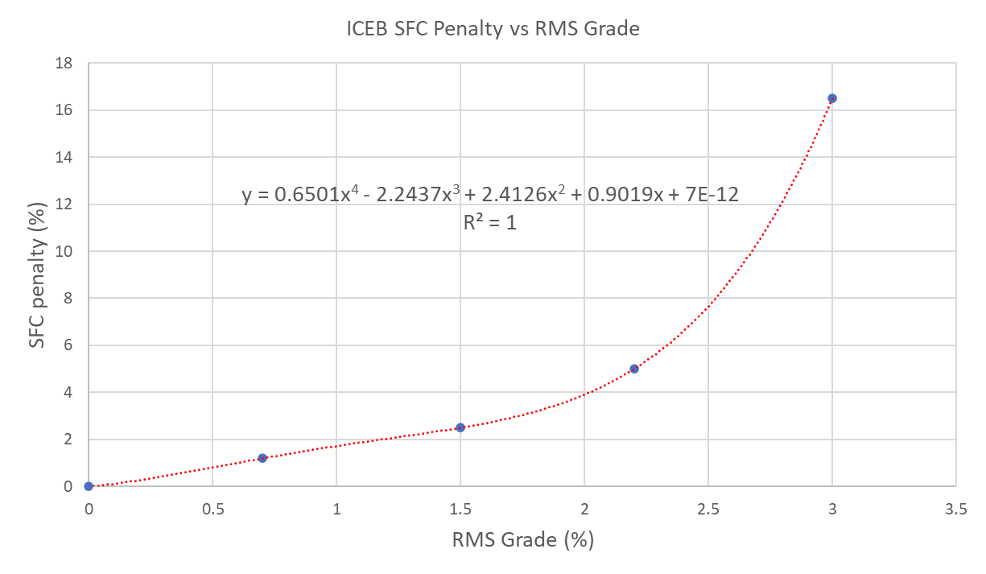
Steep Routes input
Distance from Start (km) | Gradient | SFC Penalty
0 | -1.10% | -0.27
0.09 | -2.20% | -0.56
0.18 | 1.10% | 0.30
0.27 | 2.20% | 0.68
Plot route and copy-paste route gradient data into model
Energy consumption penalty and BEB range reduction calculated for this route
Input buses on this route

Slide 13
Steep Routes input – simplified for online platform
Select a category between ‘moderately hilly’ and ‘extremely hilly’
Selection corresponds to a Specific Fuel Consumption penalty

Slide 14
Region-specific costs – optional inputs
Some aspects of CAPEX and OPEX of bus fleets vary heavily with region, for example:
Cost of grid connection for charging station
Fuel & electricity costs
Bus and equipment costs
There will be the option to input these costs instead of using a basic assumption

Slide 15
Battery Sizing
Iterative calculations done in Excel – polynomial function fitted to the results
Polynomial function for battery size can be used easily on online interface

Slide 16
Battery Sizing
Beyond a certain Utilisation rate, the battery becomes too heavy and impractical
Battery size limit
Extra bus added
Battery size halved

Slide 17
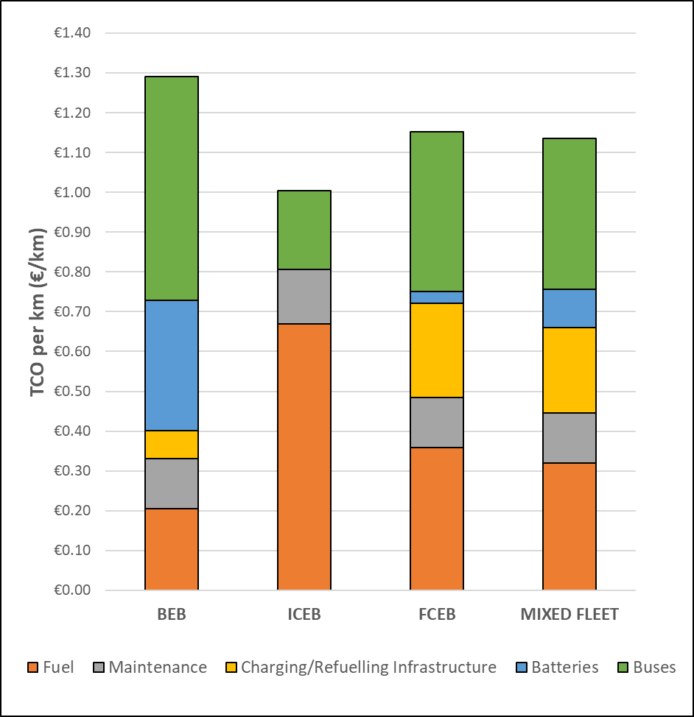
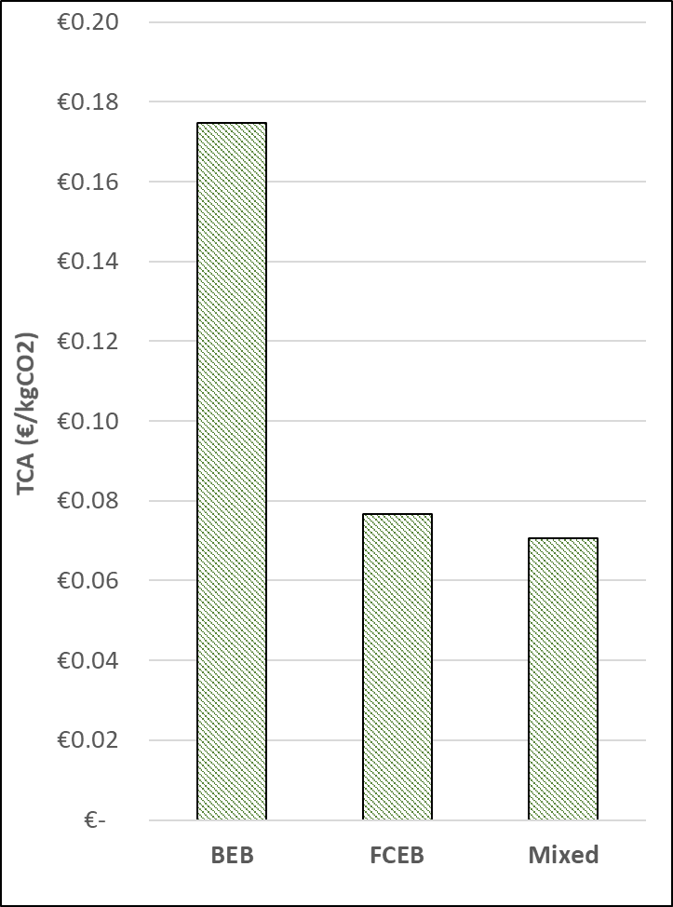
Galway City results*
Galway has 40 double-deck buses in its fleet
65% exceed the calculated battery maximum km/day. They can be decarbonized by:
A greater number of battery buses
An equal number of hydrogen buses
Total Cost of Ownership across fleet
Total Cost of Abatement across fleet
Key assumptions
Diesel price €1.75/L
Electricity price 22 c/kWh
Hydrogen price €8/kg
* These are unpublished preliminary results
All battery
All diesel
All H2
Mixed
All battery
All H2
Mixed

Slide 18
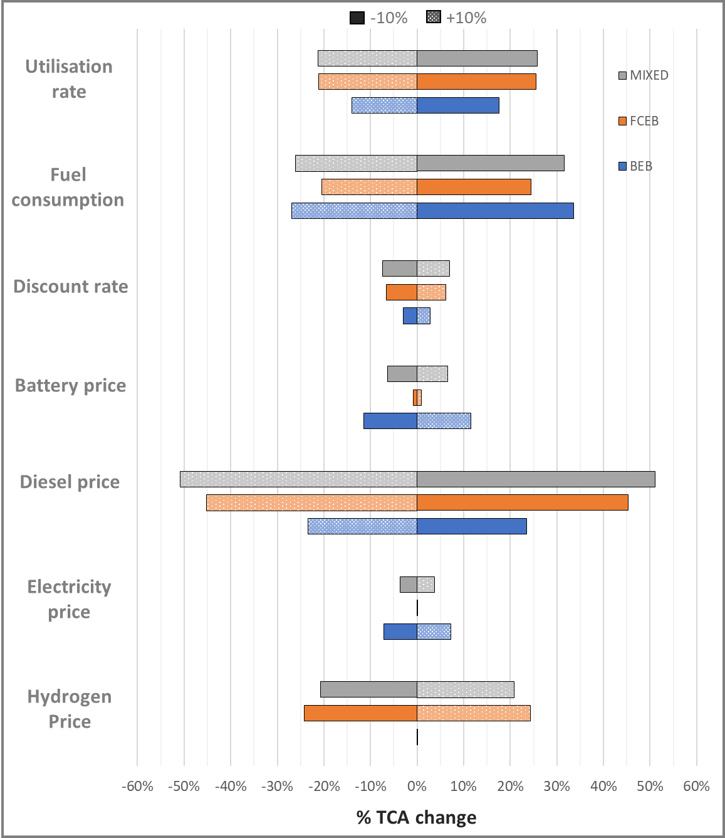
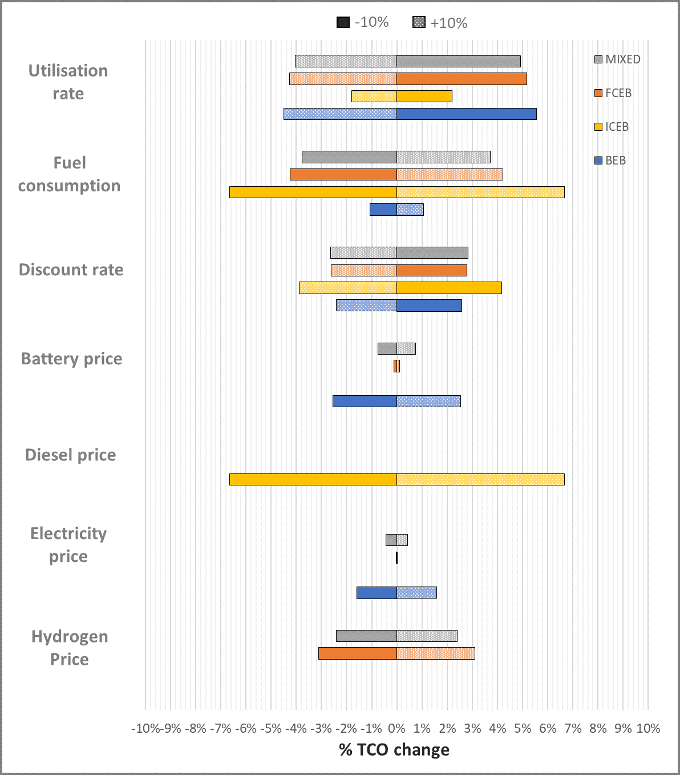
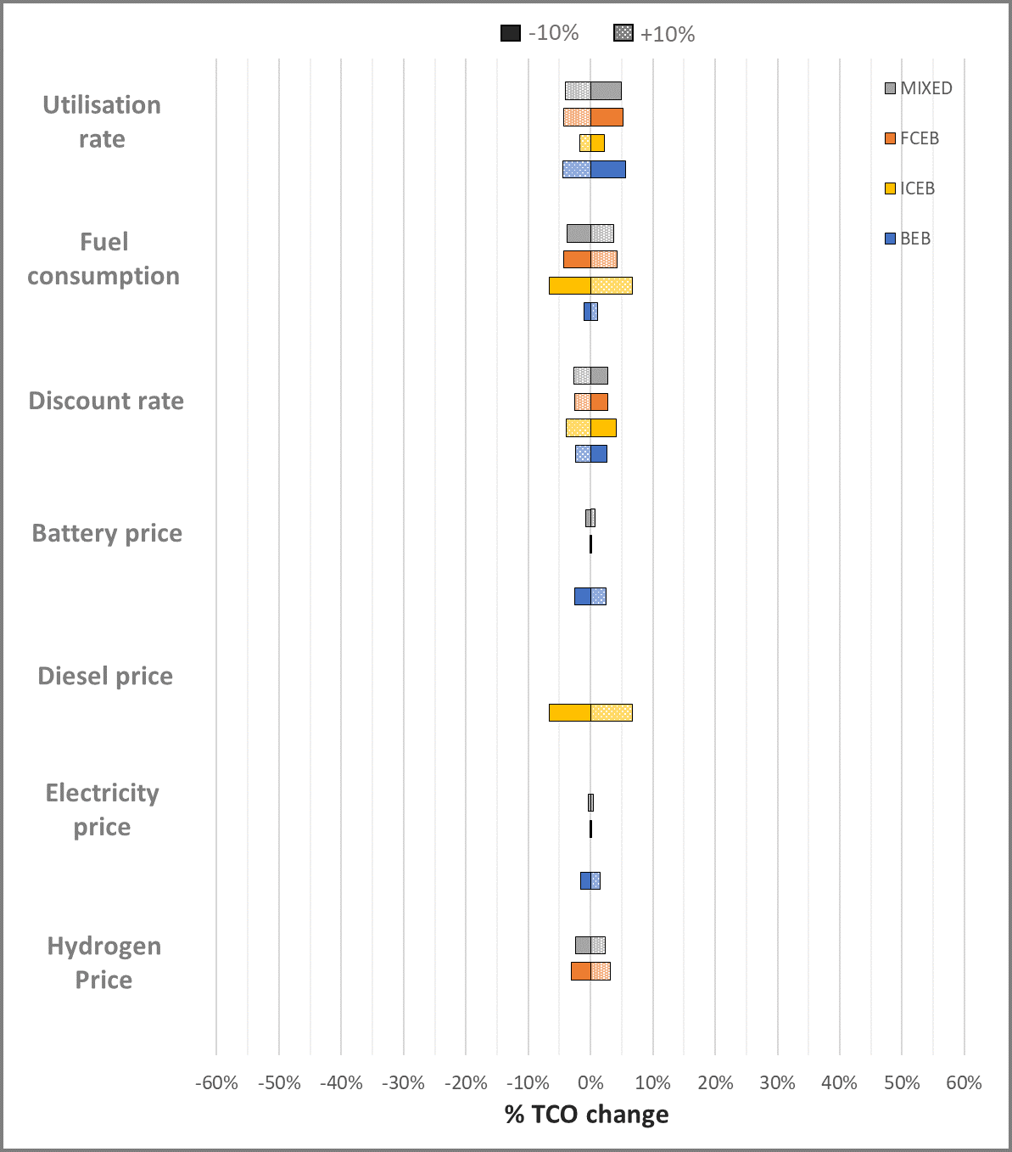
Sensitivity Analysis

Slide 19

WE ARE INTERESTED IN YOUR FEEDBACK
Please participate in the following survey
You will be asked to do a runthrough of the EST and answer a few questions
Your contribution will help us to optimize the EST https://www.soscisurvey.de/GenCommEST/
Available in English and in German
Thank you!

Slide 20
Thank You

