Slide 1
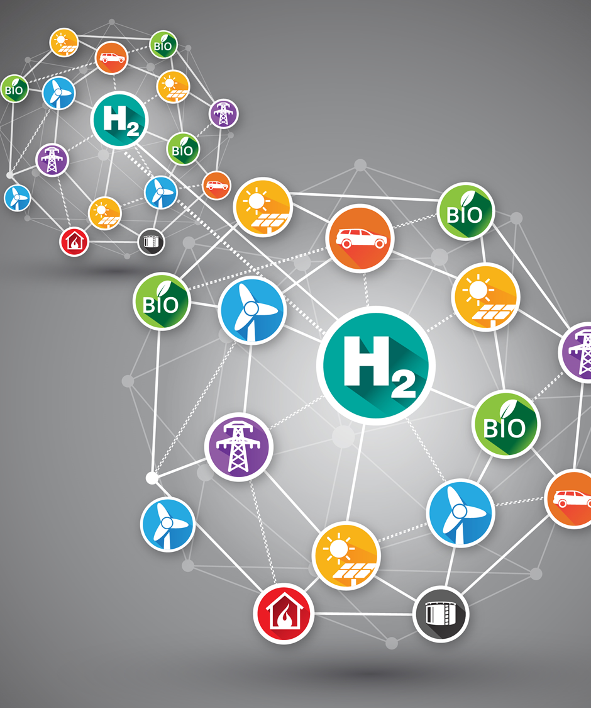
GenComm Spring ‘21 Series of H₂ Webinars SMARTH2 Webinar 4: Hydrogen Demand, Use and Future Production 18th May 2021

Slide 2
Agenda
​​​​​​​ 10:10 - 10:10:
Welcome & Introduction, Paul McCormack, Belfast Met & GenComm 10:10 - 10:30:
Scaling up H2 supply and demand across Scotland, Nigel Holmes, Scottish Fuel Cell Association 10:30 - 10:50:
USA H2 trajectory, Dan McCue, Editor, Renewable Energy Magazine, USA 10:50 - 11:10:
Tidal and Marine H2 production, Ian Williamson, European Hydrogen Association 11:10 - 11:20:
Q & A
GenComm Spring ‘21 Series of H₂ Webinars - Webinar 4: Hydrogen Demand, Use and Future Production

Slide 3
GenComm Spring ‘21 Series of H₂ Webinars - Webinar 4: Hydrogen Demand, Use and Future Production

Slide 4
“Great CH2F
“Great discoveries and improvements invariably involve the cooperation of many minds.”
Alexander Graham Bell
How best to tackle our climate change challenges than creating a forum of communities, industry, experts, academia, institutions the public sector.
http://communityh2.eu/
GenComm Spring ‘21 Series of H₂ Webinars - Webinar 4: Hydrogen Demand, Use and Future Production

Slide 5
“Audience Poll
How important a part will Green Hydrogen play in achieving net zero by 2050?
A significant role.
A key but not significant role.
A minor role.
A key role especially in areas yet to be accessed.
To answer the question, please use the chat function.
GenComm Spring ‘21 Series of H₂ Webinars - Webinar 4: Hydrogen Demand, Use and Future Production

Slide 6
“Great SMART H2
The GenComm Spring '21 Series of H2 webinars is focused on SMARTH2. Looking at how we can optimise GreenH2 to deliver increased benefits across the hydrogen value chain, accelerating cost reductions for hydrogen production, transmission, distribution, retail, and end applications.
GenComm Spring ‘21 Series of H₂ Webinars - Webinar 4: Hydrogen Demand, Use and Future Production

Slide 7
“Great Hydrogen > 2050
Demand
Use
Future production
How do we make the energy transition a reality?
GenComm Spring ‘21 Series of H₂ Webinars - Webinar 4: Hydrogen Demand, Use and Future Production

Slide 8
SMART H2
The world is racing to scale up Green Hydrogen to help meet our C02 reduction targets.
However, as we scale up the use of GREEN H2 it must be done smartly and give us SMARTH2.
PRODUCTION
H2
CONVERSION
H2
DISTRIBUTION
H2
USE
TRANSMISSION
H2
GenComm Spring ‘21 Series of H₂ Webinars - Webinar 4: Hydrogen Demand, Use and Future Production

Slide 9
GenComm Spring ‘21 Series of H₂ Webinars - Webinar 4: Hydrogen Demand, Use and Future Production

Slide 10
“Great H2 Escalator
Escalate the value of Green H2 in every step of the value chain.
One of the strengths of hydrogen is its versatility both in terms of production across technologies and use by industry and individual, and also its potential as a storage and back up medium at a time when intermittent renewables is increasingly dominating the electricity system.
GenComm Spring ‘21 Series of H₂ Webinars - Webinar 4: Hydrogen Demand, Use and Future Production

Slide 11
“Great The new Energy Normal
Business as usual is no longer an option.
We must increase our pace towards a net-zero future.
Climate change presents a fundamental challenge to society. It is a shared challenge, and all must play their role.
GenComm Spring ‘21 Series of H₂ Webinars - Webinar 4: Hydrogen Demand, Use and Future Production

Slide 12
GenComm Spring ‘21 Series of H₂ Webinars - Webinar 4: Hydrogen Demand, Use and Future Production

Slide 13
“
Hydrogen Optimisation Support Tool
‘Hydrogen is the catalyst driving Europe’s energy transition. Optimising this journey through valorization of the hydrogen supply chain, production, storage and use is key to creating a successful hydrogen Europe.’
Extensive development and demonstration
skills & experience in innovation driven Hydrogenewable projects optimising
GreenH2 to become SMARTH2
GenComm Spring ‘21 Series of H₂ Webinars - Webinar 4: Hydrogen Demand, Use and Future Production

Slide 14
Q & A
GenComm Spring ‘21 Series of H₂ Webinars - Webinar 4: Hydrogen Demand, Use and Future Production

Slide 15
GenComm Spring ‘21 Series of H₂ Webinars - Webinar 4: Hydrogen Demand, Use and Future Production

Slide 16
Social Distance Calling Card
GenComm Website - nweurope.eu/gencomm
LinkedIn - GenComm
Twitter - @GenComm_CH2F
Community Hydrogen Forum – CH2F - communityh2.eu
Hydrogen Ireland website - hydrogenireland.org
GenComm Spring ‘21 Series of H₂ Webinars - Webinar 4: Hydrogen Demand, Use and Future Production

