Slide 1




GenComm Pilot Plant: Solar-Powered Hydrogen Refuelling Station
Dr. Bodo Groß, IZES gGmbH
September 22nd 2020

Slide 2


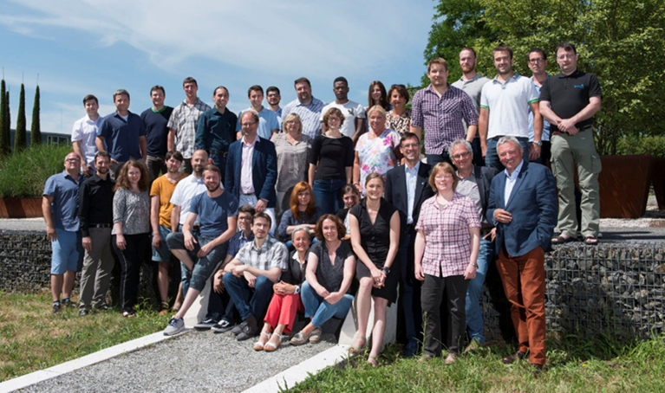

Agenda
Department Technical Innovations: Mobility Projects
GenComm Project
Status of the Solar Powered Hydrogen Refuelling Station located in the Innovation Campus Saar
Outlook & Conclusions
Picture Source: IZES gGmbH

Slide 3
Department Technical Innovations
            Activities in the Research Field „Alternative Mobility“
      Planning, development, construction and operation of innovative infrastructure for alternative mobility concepts, especially for battery (BEV) and fuel cell electric vehicles (FCEV)
      Current Project for BEV
      OptiCharge⁺: Increasing the efficiency of the OptiCharge charging station, in particular by optimising the functional materials of the VRFB and the energy management system and by setting up a DC micro-grid and connection of the entire charging station to the Internet of Things; project duration 12/2019 – 11/2022 (Previous project: OptiCharge, duration 08/2015 – 12/2018)

Slide 4
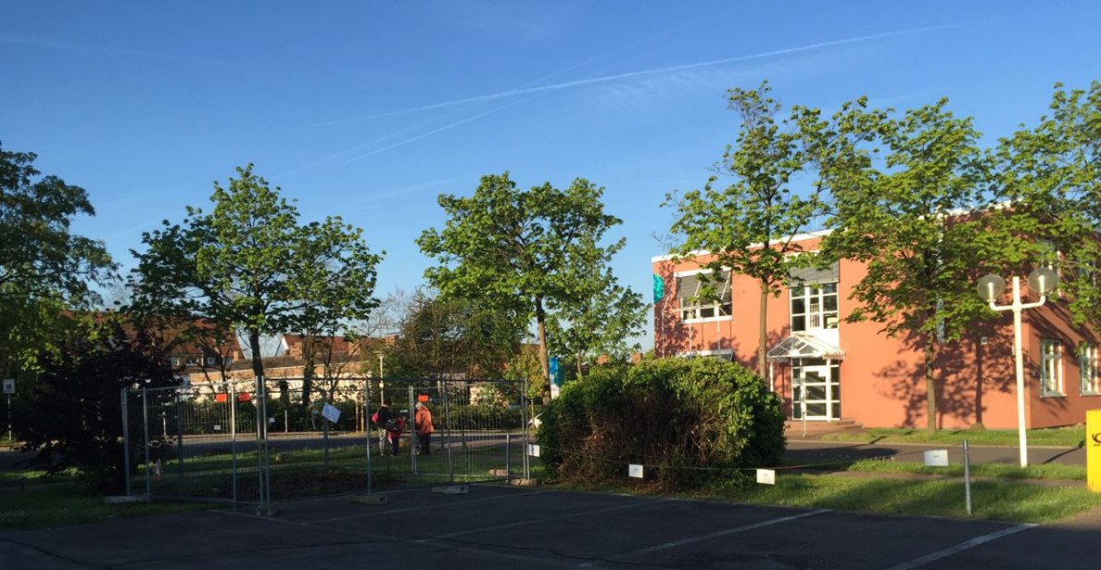
OptiCharge/OptiCharge⁺ Construction Phase I
Picture Source: IZES gGmbH

Slide 5
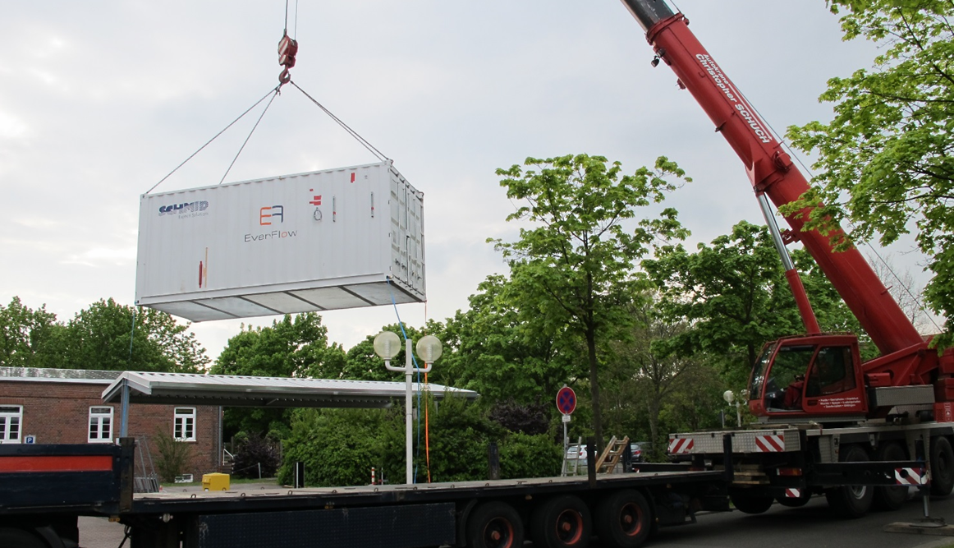
OptiCharge/OptiCharge⁺ Construction Phase II
Picture Source: IZES gGmbH

Slide 6
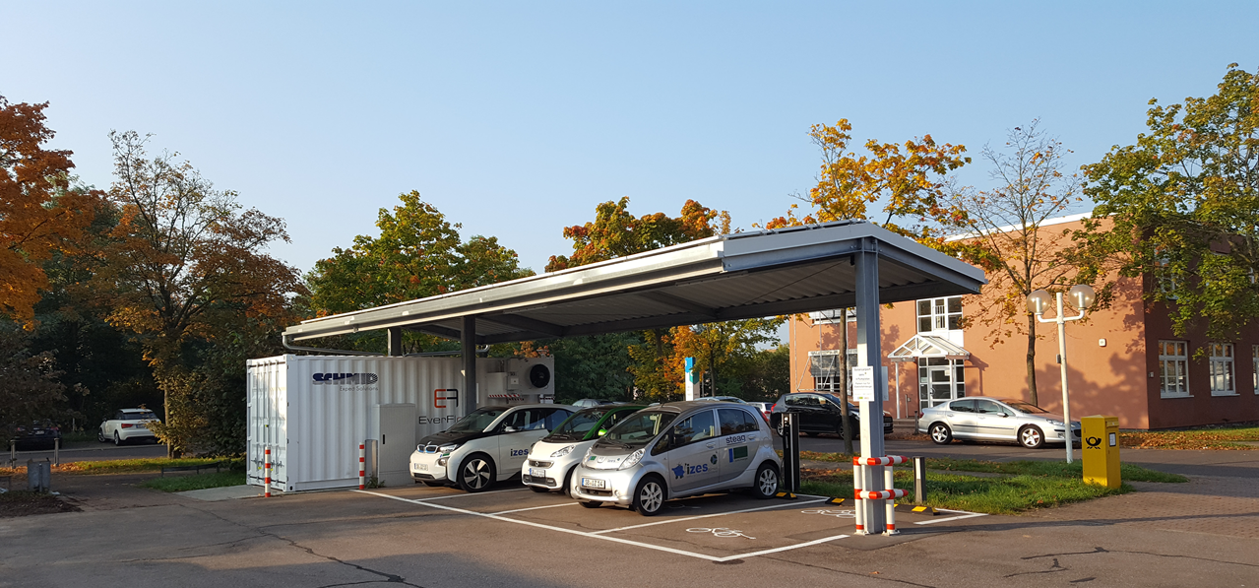
OptiCharge/OptiCharge⁺ Construction Phase III
Picture Source: IZES gGmbH

Slide 7
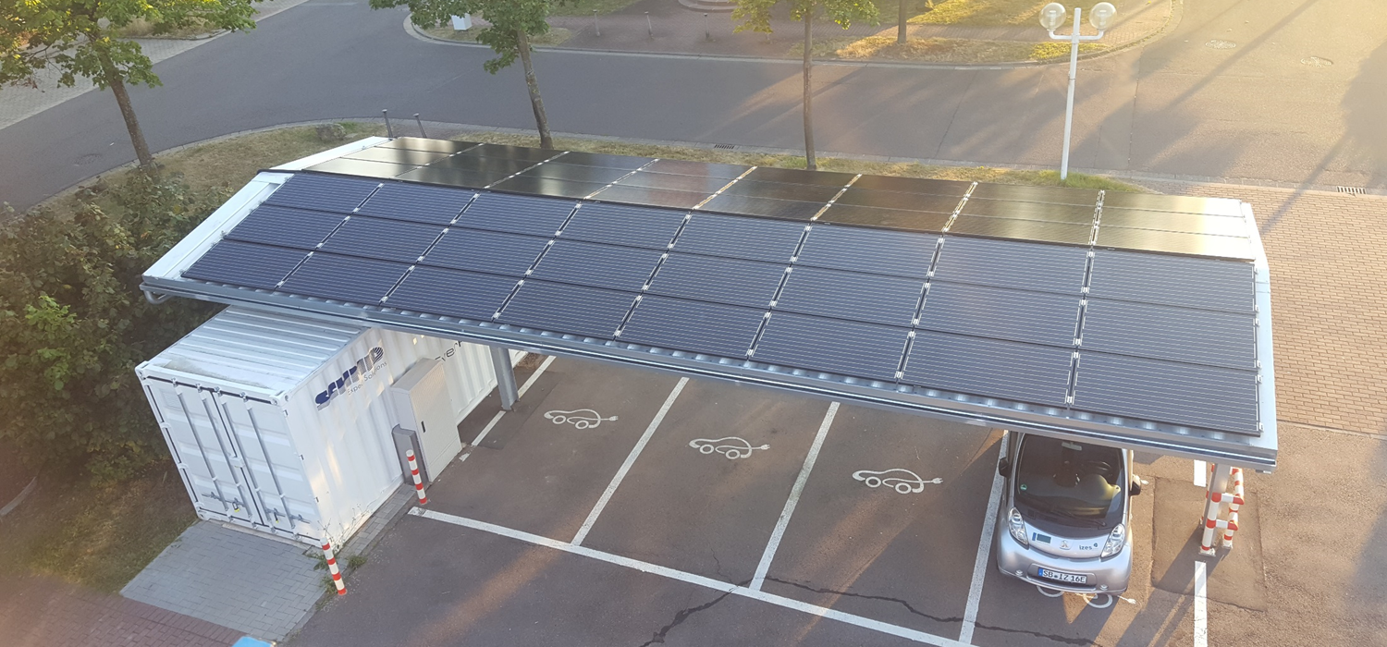
OptiCharge/OptiCharge⁺ Construction Phase IV
Picture Source: IZES gGmbH

Slide 8
Interreg NWE Project GenComm – Overview
      Current Project in the Field of FCEV
      GenComm: GENerating energy secure COMMunities. Smart Hydrogen - Integrated renewable energy, generation & storage to develop a new model for exploiting remotely generated electricity from renewable sources to provide energy security for remote communities.
      GenComm Partner
      Belfast Metropolitan College (UK); Energia Group (UK); HyEnergy (UK); Pure Energy Centre (UK); National University of Ireland Galway (ROI); TK Renewables (UK); BURN Joint Research Group, Vrije Universiteit Brussels (BE); INSA Rouen Normandie (FR); ENSICAEN Caen (FR)

Slide 9
Interreg NWE Project GenComm – Overview
            Main tasks of GenComm
      Implementation and operation of three “Hydrogen pilot plants" in different size classes (25, 100 and 500 kW electrolysis capacity)
      Supply of the electrolysers with different renewable energy sources (Solar-, Bio-, and Wind-Energy)
      Usage of the green Hydrogen in three different sectors (Mobility, Heat und Electricity)
      Validation of the maturity/technology readiness level of the used Hydrogen technologies
      Development of an Internet-based technical and financial instrument or the so-called "Decision Support Tool" with regard to Hydrogen technologies (for more information :http://communityh2.eu/)

Slide 10
Interreg NWE Project GenComm – IZES Work Package
      IZES Work Package
      IZES Part: Construction and operation of a solar powered Hydrogen refuelling station; project duration: 03/2017 – 09/2021
      Data for the IZES solar powered Hydrogen refuelling station
      Location: Innovation Campus Saar, 66115 Saarbrücken, Altenkesseler Straße 17A1, Headquarter IZES gGmbH
      Renewable energy source: Solar-Energy; PV-Array with 30 kW peak power
      Hydrogen production: Electrolysis; Simultaneous usage of AEM and PEM electrolyser, maximum H₂ production: 5 Nm³/h
      Gas quality: 5.0 or 99,999%
      Hydrogen storage: 58 kg storage capacity at two different pressure levels 450/950 bar
      Suitable for 700 bar vehicles; the maximum refuelling time is 30 min
      Containerised solution; two 20 feet container with a separated dispenser
      Operation as a non-public station

Slide 11
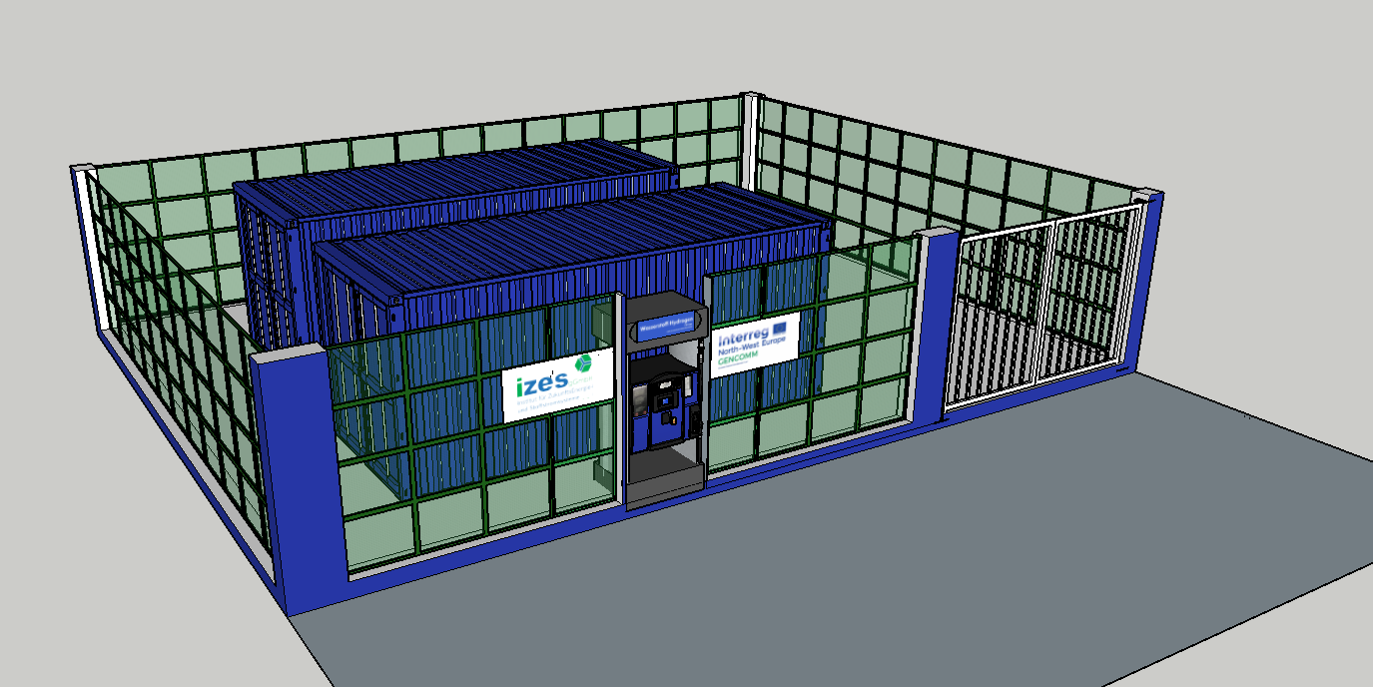
Project GenComm
Schematic Diagram of the Planned Hydrogen Refuelling Station
Picture Source: IZES gGmbH

Slide 12
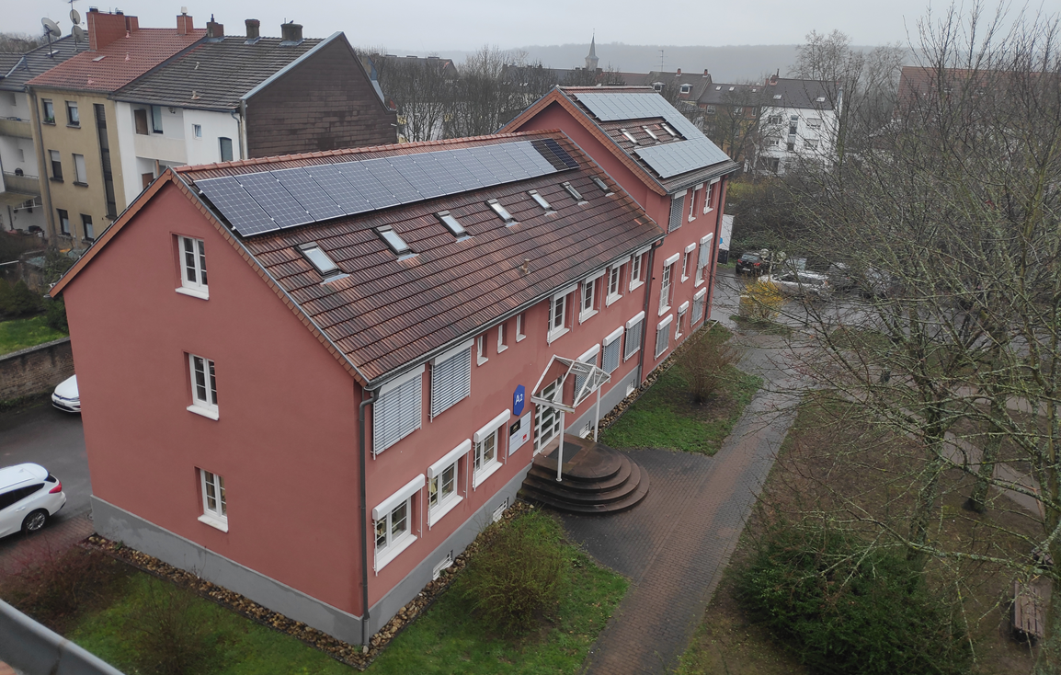
Projekt GenComm
Construction Phase I
Picture Source: IZES gGmbH

Slide 13
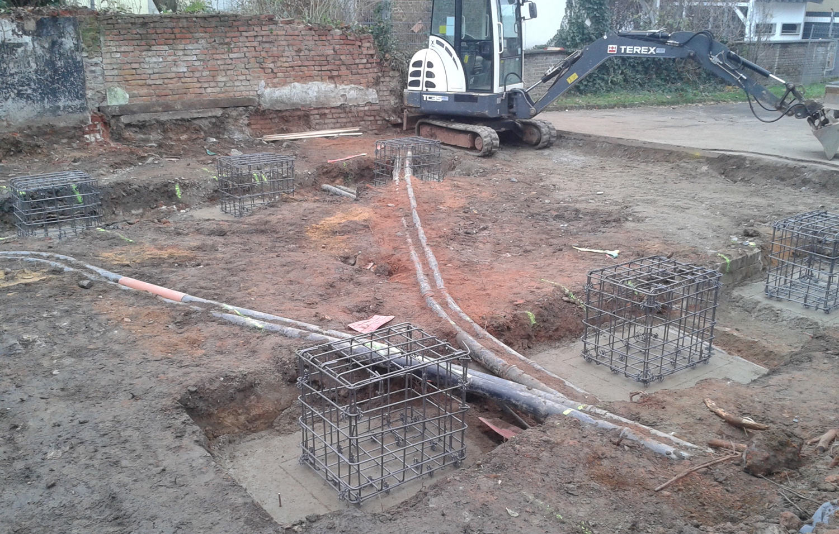
Projekt GenComm
Construction Phase II
Picture Source: IZES gGmbH

Slide 14
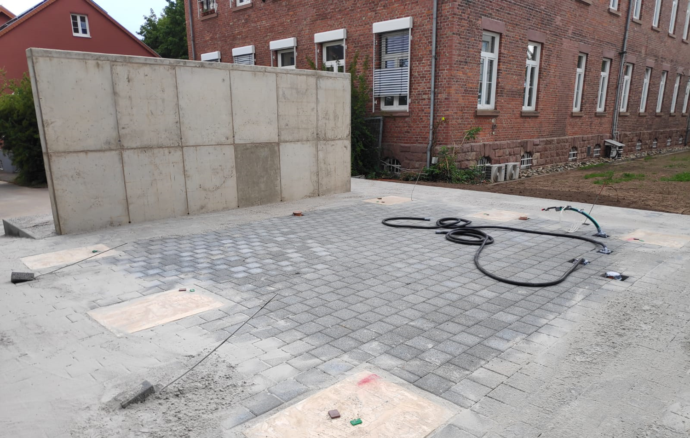
Projekt GenComm
Construction Phase III
Picture Source: IZES gGmbH

Slide 15
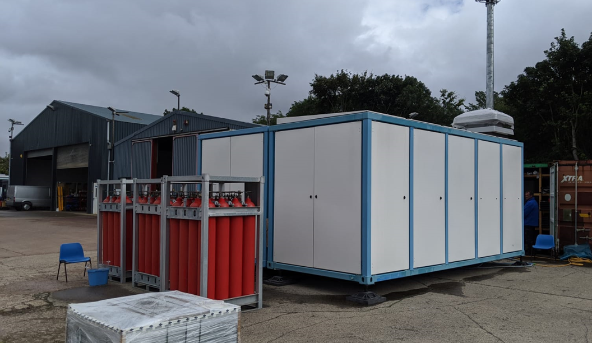
Projekt GenComm
Construction Phase IV
Picture Source: logan Energy Ltd.

Slide 16
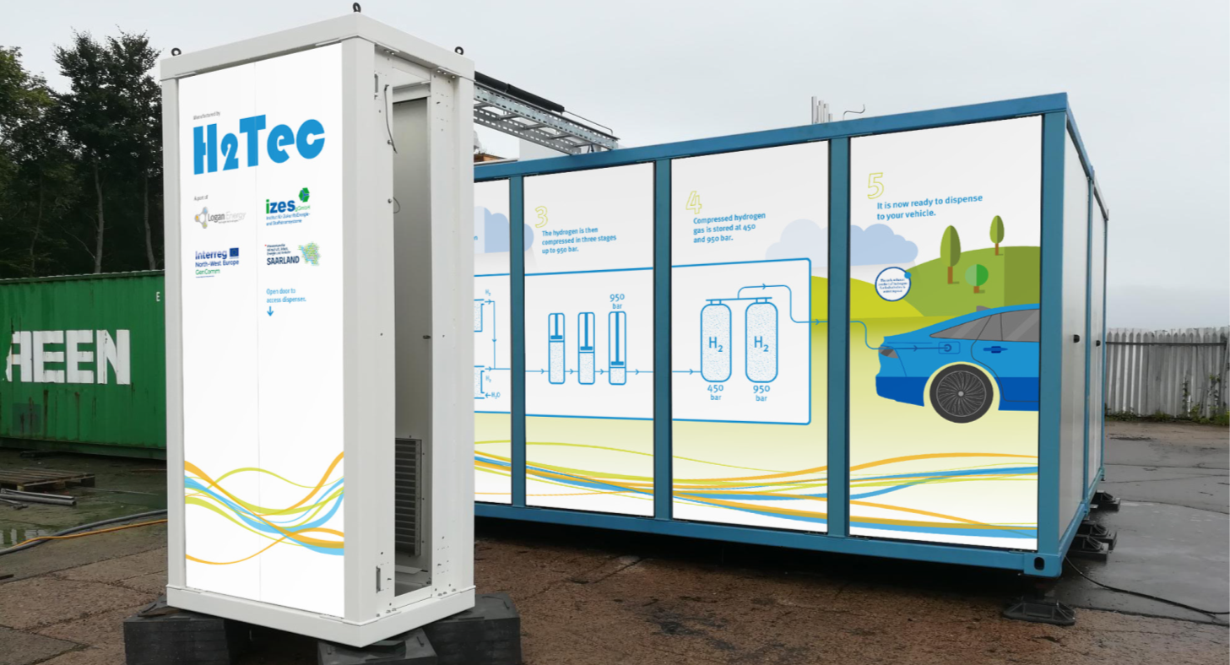
Project GenComm
Construction Phase VI
Picture Source: logan Energy Ltd.

Slide 17
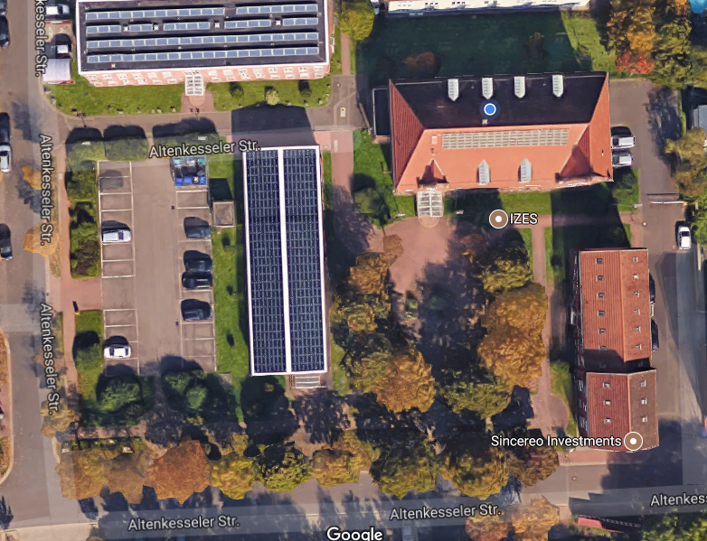
Location of the IZES Facilities in the Innovation Campus Saar in Saarbrücken
Planned location of the Hydrogen Refuelling Station
OptiCharge Charging Station
Office building of the IZES gGmbH
PV-Array to supply the Hydrogen refuelling station
Vanadium Redox
Flow Battery
Picture Source: google maps, edited by IZES gGmbH

Slide 18
Outlook
Finalisation and delivery of the Hydrogen refuelling station is expected in 4Q20
Civil works expected to be completed by the end of 2020 (shortly after the delivery)
Operating permit for the refuelling station is expected by mid of 1Q21

Slide 19
Conclusion
Picture Source: Clean Energy Partnership, CEP; Jörg Starr; NOW Beiratstreffen June 13th, 2019
The Power to Change: Hydrogen has the potential to decarbonise (not only) the transport sector sustainably!

Slide 20
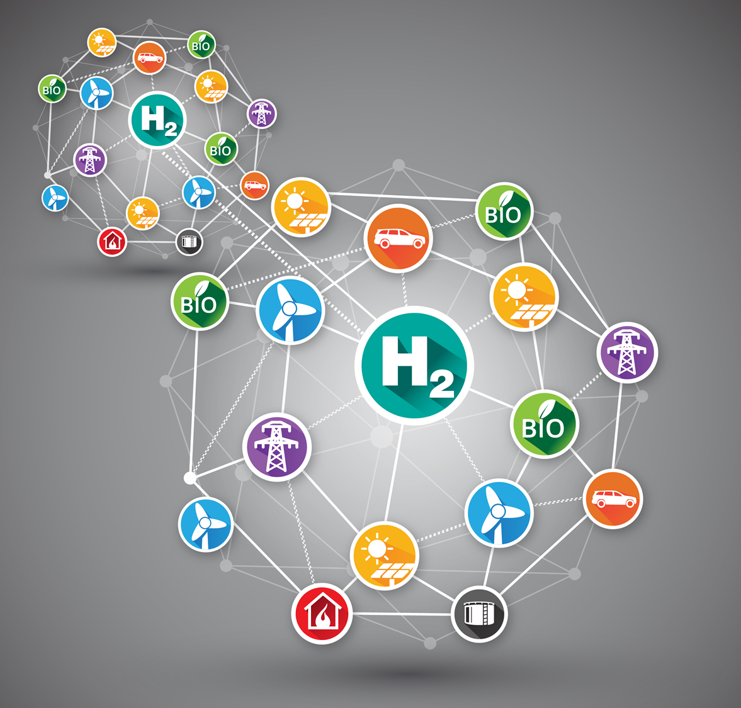

Thank you for Listening!
Dr. Bodo Groß
IZES gGmbH
Altenkesseler Straße 17, Geb. A1
Germany - 66115 Saarbrücken
gross@izes.de

