Slide 1
Circular Housing Asset Renovation & Management – No More Downcycling
ONLINE TUTORIAL PART 3: MATERIAL EXCHANGE PLATFORMS
Prof. Vincent Gruis
Delft University of Technology
Notes:
Welcome back to our online tutorial.
In the second part of our tutorial, we discussed the business model principles of the demonstration projects in CHARM.
In this third part, we turn our attention to the material exchange platforms, again using the sustainable business model canvas to explain the main principles.

Slide 2
Key Stakeholders
Key Activities
Profit:
Value that is offered to customers
Customer Relationships
Customer segments
Value creation
Value propo-sition
Value delivery
Key Resources & Capabilities
People:
Positive impact for common interest of society
Planet:
Positive impact for the environment
Channels
Value capture
Cost structure
Revenue Streams
Sustainable business model canvas. Source: Bocken et al. (2018) based on Osterwalder &Pigneur (2010) and Richardson (2008)
Notes:
For those of you who have not watched the second part of the tutorial, the sustainable business model canvas starts from the value propositions, which are placed in the center.
The value propositions are divided in three categories, following the well-known people, planet, profit distinction.
Overall, all the approaches in CHARM start from the planet motivation. Everything has been developed to reduce waste and emissions, either by re-using materials now, or to prevent waste in the future.
This does not lead to more profit. There are costs involved in making materials re-useable and to construct for future re-usability and waste prevention. On the other hand, we also prevent having to buy new materials, so there is a plus as well.
The value for the people, is directly derived from the environmental objectives.

Slide 3
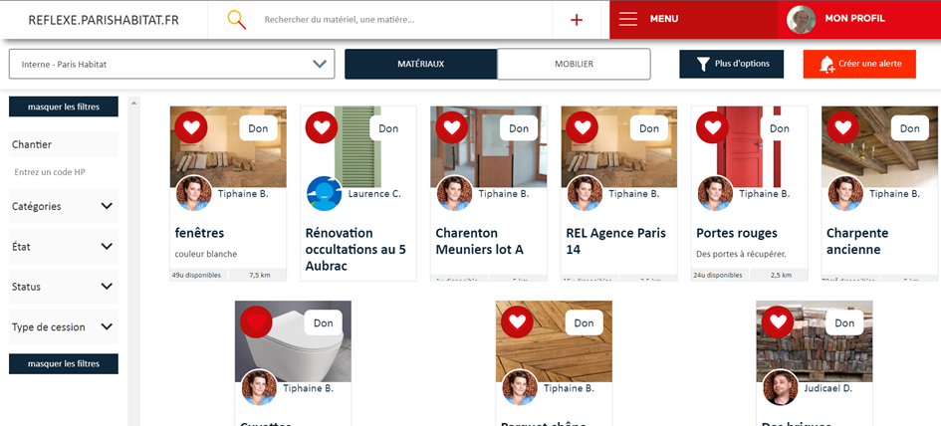
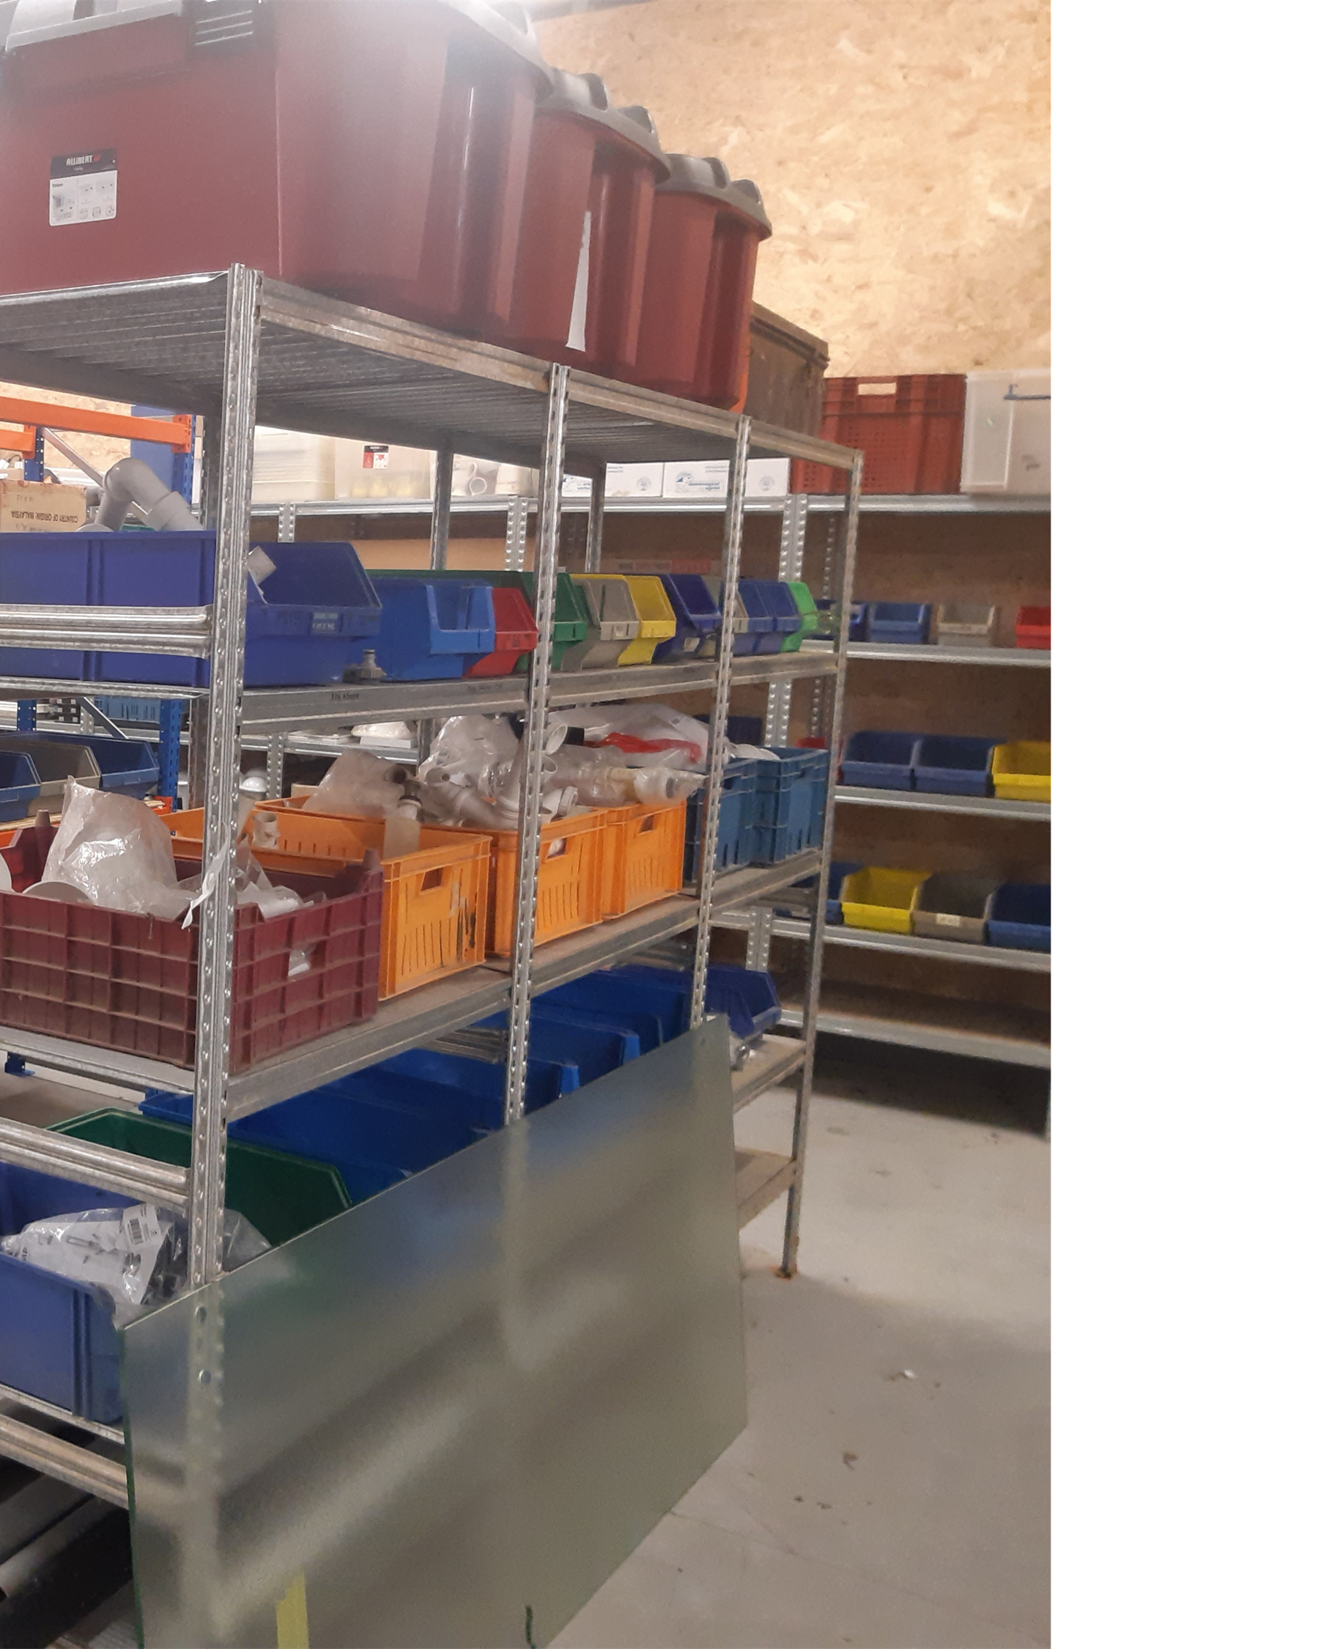
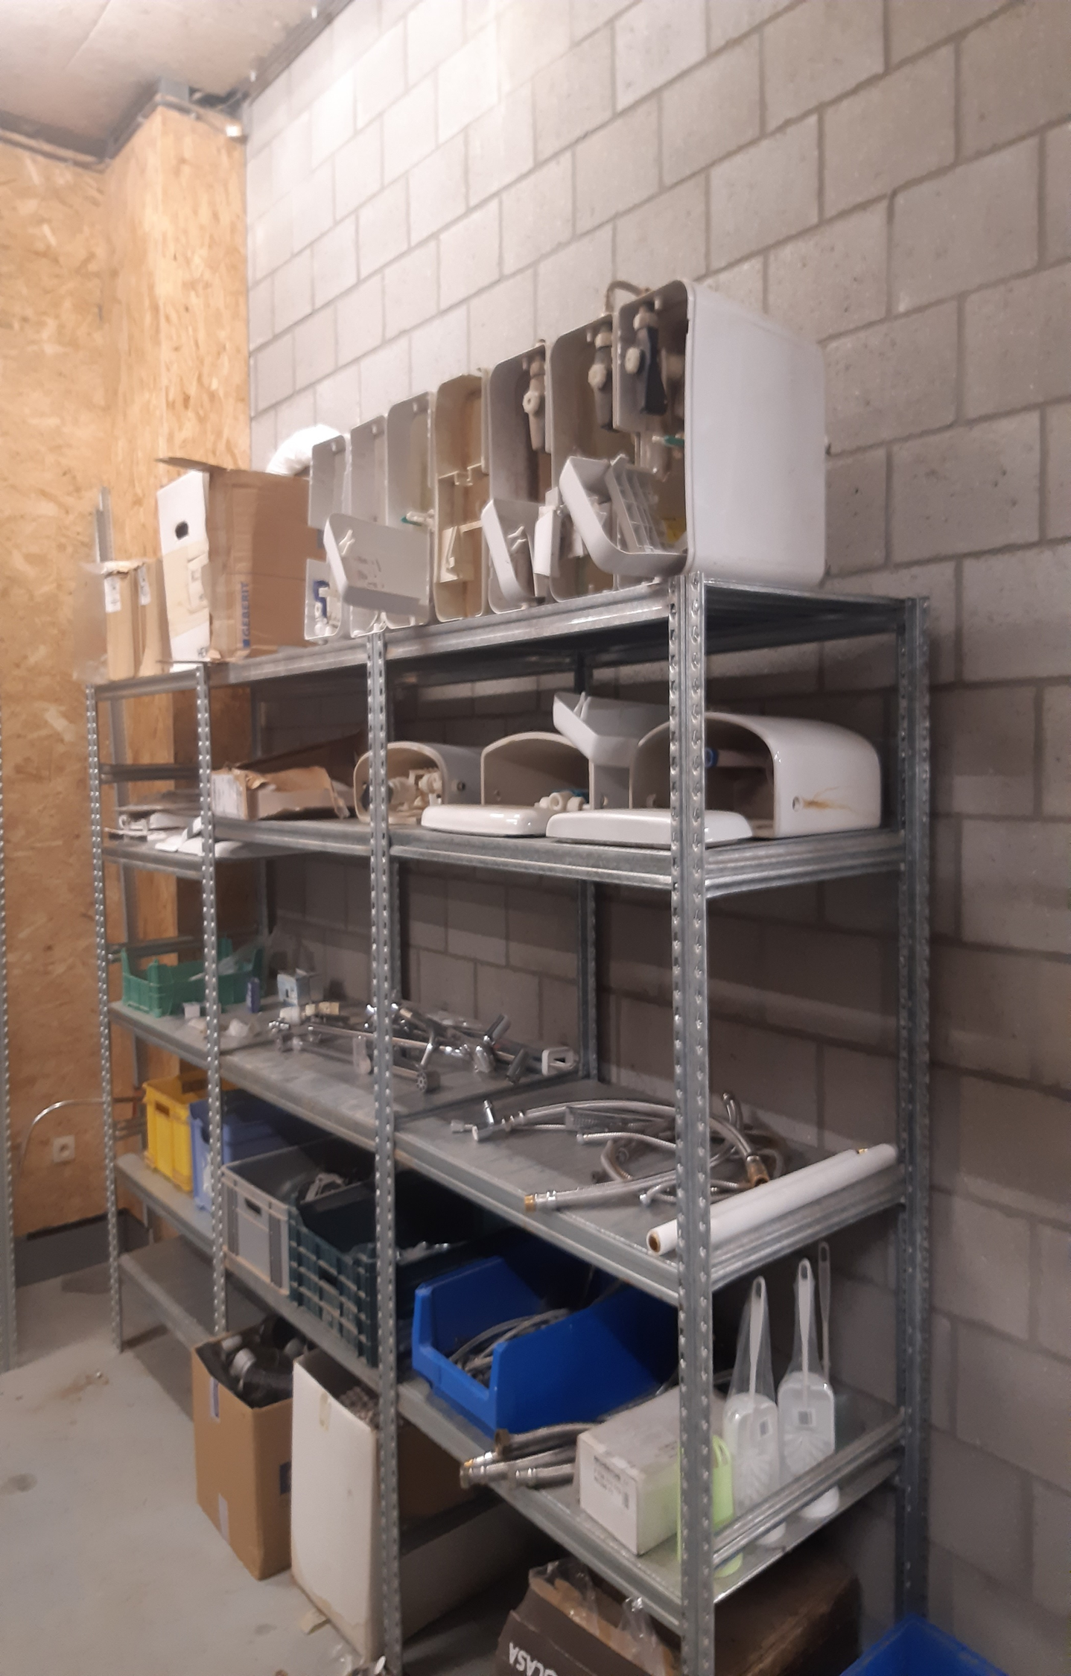
Value propositions exchange platforms
Digital MEP
Profit:
Value that is offered to customers
Easy access to available materials by internal project officers and external contractors
Value propo-sition
Physical MEP
People:
Positive impact for common interest of society
Planet:
Positive impact for the environment
Notes:
In addition to the demonstration projects, two material exchange platforms have been developed in CHARM.
One digital platform, by Paris Habitat CLICK and one physical platform, by Zonnige Kempen. CLICK
In general, the value propositions of the platforms are similar to the overall value propositions of circular strategies for housing construction and renovation. Because they enable re-use of materials, they contribute both to the reduction of waste as well as to avoiding environmental burdens and financial costs of having to produce and buy new products.
When we zoom in, we notice that the primary costumers, or better perhaps users of the platforms, are not the tenants, but the people working in the supply chain. These range from internal employees, such as handymen and project managers, to external partners, including architects and contractors.
The main value that is offered to these users is that it enables them to work with re-used materials, stemming from the portfolio of both housing organisations. CLICK
In the case of Paris Habitat’s digital platform, the professionals gain insight in which materials will become available for re-use from running projects and also how long they will remain available. This allows them to opt for re-using these materials in other projects, on other sites.
In the case of Zonnige Kempen’s physical platform, the storage of re-usable materials enables the maintenance personnel to quickly carry out repairs, without having to wait for the delivery of new products.
So, in essence, the value proposition of the exchange platforms is quite simple: it makes re-use possible in practice.

Slide 4
Value delivery exchange platforms
Customer Relationships:
Relation between user and organisation
Customer segments:
Target groups who make use of the offering
Internal users as suppliers
Internal and external
users as clients
Internal users:
Project managers
Maintenance officers
External users:
Contractors
Architects
(Potential) customers:
Other housing organisations
Tenants
Value delivery
Channels:
Touchpoints between users and organisation
Physical platform: storage management by internal maintenance officers
Digital platform: regular newsflashes of new offers
Notes:
CLICK When we turn to the value delivery in the exchange platforms, we can make a distinction between internal and external costumers.
CLICK The internal users operate both as suppliers, indicating when new materials for reuse become available, as well as clients, or potential users of the reclaimed materials.
CLICK In the digital platform, this can be supported by regular newsflashes to indicate when new materials become available and also when materials are claimed through the platforms.
But there are also other, potential, costumers. Zonnige Kempen for example, wants to explore if they can also grant their tenants access to their physical material exchange platform, so they can buy materials for a small fee.
And Paris Habitat is exploring if they can open up their material exchange platform to other housing organisations. Complicating factor in these cases is that our social housing partner organisations are embedded in a public regulatory framework that limits their possibilities to trade in materials and building components.

Slide 5
Value creation exchange platforms
Key Stakeholders:
Internal and external supply chain partners
Key Activities:
Processes to produce the product, service and value
Collect, clean, repair, store, register and communicate availability of materials
Express interest in available materials and incorporate in design
Trained professionals
ICT
Storage place
Internal stakeholders:
Project managers
Maintenance officers
Communication officers
External stakeholders:
Specialised contractors
Specialised architects
ICT contractors
Value creation
Key Resources & Capabilities:
Human, material and financial resources
Notes:
The value creation in the material exchange platforms takes place in part by the regular stakeholders, such as internal project managers, maintenance and communication officers, as well as contractors and architects with expertise in working with reclaimed materials CLICK.
Additionally, for the digital exchange platform, Paris Habitat contracted an external ICT developer to set up the database and web-based interface tool.
Working with re-used materials also implies a lot of additional activities in the process CLICK, such as the collection, cleaning, repairment, registration and storage of materials.
Moreover, it requires effort from project managers to both communicate about the upcoming availability of materials as well as to express and act upon the interest to re-use these materials.
Thus, key resources are trained professionals, as well as the ICT tooling in case of the digital platform, and the storage place in case of the physical platform.
Ideally both physical and digital platforms are intertwined, in case materials do not find a new use during their initial period of availability.

Slide 6
Key Stakeholders
Key Activities
Profit
Customer Relationships
Customer segments
Value creation
Value propo-sition
Value delivery
Key Resources & Capabilities
People
Planet
Channels
Value capture
Cost structure
Revenue Streams
Sustainable business model canvas. Source: Bocken et al. (2018) based on Osterwalder &Pigneur (2010) and Richardson (2008)
Notes:
The value capture part of the sustainable business model canvas, also the fourth and final part, consists of a simple division between costs and revenues.
As we explained when we discussed the value propositions, the approaches developed in CHARM do not lead to additional financial revenues.
Mainly, there are costs involved in making materials re-useable and to construct for future re-usability and waste prevention as well as to develop and maintain the material exchange platforms.
The main financial revenue is that costs are saved because the social housing organisations need to purchase less new materials, now and in the future.

Slide 7
ASK YOURSELF…
Key Stakeholders
Key Activities
Profit
Customer Relationships
Customer segments
?
?
?
Value creation
Value propo-sition
Value delivery
Key Resources & Capabilities
People
Planet
Channels
?
Value capture
Cost structure
Revenue Streams
Sustainable business model canvas. Source: Bocken et al. (2018) based on Osterwalder &Pigneur (2010) and Richardson (2008)
Notes:
With this brief overview of the business model principles of the material exchange platforms, we conclude the third and final part of this tutorial.
Again, we encourage you to ask yourself: CLICKCLICKCLICKCLICK
What are the added values in your circular initiatives and ideas
And what and who do you need to deliver this?

Slide 8
THANK YOU!
Notes:
On behalf of all our partners, we thank you for watching our tutorial.
On our website, we have included some links for if you want to know more about our and related projects.
And we wish you all the best with realizing YOUR circular ambitions!

