Slide 1
Circular Housing Asset Renovation & Management – No More Downcycling
ONLINE TUTORIAL PART 2: DEMONSTRATION EXEMPLARS
Prof. Vincent Gruis
Delft University of Technology
Notes:
In the fist part of the tutorial, we explained the background of the CHARM project.
Now, in this second part, we dive deeper into the content.
In this part we provide insight in the demonstration exemplars of CHARM.

Slide 2
Key Stakeholders
Key Activities
Profit:
Value that is offered to customers
Customer Relationships
Customer segments
Value creation
Value propo-sition
Value delivery
Key Resources & Capabilities
People:
Positive impact for common interest of society
Planet:
Positive impact for the environment
Channels
Value capture
Cost structure
Revenue Streams
Sustainable business model canvas. Source: Bocken et al. (2018) based on Osterwalder &Pigneur (2010) and Richardson (2008)
Notes:
As explained in the first part of the tutorial, we will follow the sustainable business model canvas to explain the demonstration exemplars.
The sustainable business model canvas starts from the value propositions, which are placed in the center. CLICK
The value propositions are divided in three categories, following the well-known people, planet, profit distinction.
Overall, all the approaches in CHARM start from the planet motivation. CLICK Everything has been developed to reduce waste and emissions, either by re-using materials now, or to prevent waste in the future.
This does not lead to more profit. There are costs involved in making materials re-useable and to construct for future re-usability and waste prevention.
On the other hand, we also prevent having to buy new materials, so there is a plus as well.
The value for the people, is directly derived from the environmental objectives. Moreover, as we will show, our partners also use the circular approaches to stimulate awareness of how important this is to tenants.

Slide 3
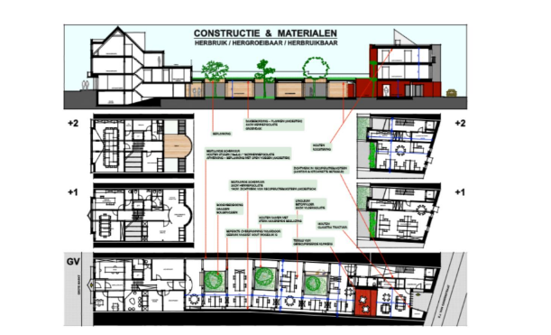
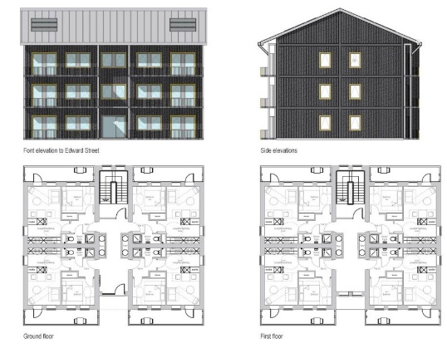
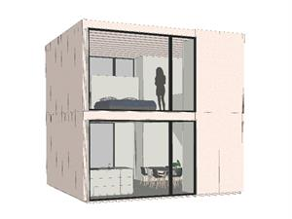
Value propositions demonstration projects
Paris Habitat
Zonnige Kempen
Profit:
Value that is offered to customers
prevent waste and new materials
education and awareness
Value propo-sition
GreensquareAccord
Woonbedrijf
People:
Positive impact for common interest of society
Planet:
Positive impact for the environment
prevent plastic pollution
temporality with reuseability
Notes:
When we dive a bit deeper into the demonstration projects developed in CHARM we can see more nuanced value propositions.
CLICK In case of Paris Habitat’s strategy to renovate with refurbished building components, there is a clear strategy to prevent waste and reduce production of new components during the running operations.
CLICK In case of GreensquareAccord’s plastic free house, there is a focus on the prevention of pollution through plastic in the far future.
CLICK In the case of Zonnige Kempen’s circular office and housing project, there is an emphasis on educating the employees, which gained experience with circular practices in their own working environment before starting with housing projects,
Also it is used to showing the tenants how good it can get if you work with re-used materials, thereby increasing the support for applying circular approaches in housing.
CLICK In the case of Woonbedrijf, the challenge was to built housing that would only be used for 15 years on the intended location. Therefore, it was important to develop these dwellings in a re-usable way, so the houses would not go to waste after 15 years, but could be used again on another location.

Slide 4
Key Stakeholders
Key Activities
Profit
Customer Relationships:
Relation between user and organisation
Customer segments:
Target groups who make use of the offering
Value creation
Value propo-sition
Value delivery
Key Resources & Capabilities
People
Planet
Channels:
Touchpoints between users and organisation
Value capture
Cost structure
Revenue Streams
Sustainable business model canvas. Source: Bocken et al. (2018) based on Osterwalder &Pigneur (2010) and Richardson (2008)
Notes:
The value propositions also have to be delivered to the costumers.
The sustainable business model canvas distinguishes three aspects of value delivery:
the costumer relationships
the channels
and the costumer segments.

Slide 5
Value delivery demonstration projects
Customer Relationships:
Relation between user and organisation
Customer segments:
Target groups who make use of the offering
Tenants as clients
Tenants as co-designers
Housing customers:
Tenants
Material costumers:
Project managers
Maintenance officers
Contractors
Architects
Value delivery
Channels:
Touchpoints between users and organisation
Awareness activities & design workshops with tenants and stakeholders
Notes:
On the right side of this slide you see the customers in the demonstration exemplars in CHARM. CLICK
When employing the canvas to CHARM, we can make a distinction between the customers of the housing - in our case tenants of social housing - and the costumers for the reclaimed materials.
When working with reclaimed materials, employees within the social housing organisations or their supply chain partners, such as architects and contractors, can also be seen as clients, when they act on the demand side for these materials.
And Woonbedrijf followed a completely different design process, in which the future tenants were not only treated as customers but also as co-designers. CLICK
Thus the channels require much more intensive contact with both internal and external parties CLICK and in all of our demonstration exemplars a lot of attention was paid to awareness activities with housing and material customers.

Slide 6
Key Stakeholders:
Internal and external supply chain partners
Key Activities:
Processes to produce the product, service and value
Profit
Customer Relationships
Customer segments
Value creation
Value propo-sition
Value delivery
Key Resources & Capabilities:
Human, material and financial resources
People
Planet
Channels
Value capture
Cost structure
Revenue Streams
Sustainable business model canvas. Source: Bocken et al. (2018) based on Osterwalder &Pigneur (2010) and Richardson (2008)
Notes:
The left side of the sustainable business model canvas focusses on aspects of value creation.
First, we have the key stakeholders: who are the partners in the value creation
Second, there are key activities: what is actually done to create the value
And, third, we need key resources: what is necessary to be able to create the value.

Slide 7
Value creation demonstration projects
Key Stakeholders:
Internal and external supply chain partners
Key Activities:
Processes to produce the product, service and value
Redesign of standard housing product
Inventory of materials
Refurbishment of products
Developing material exchange platform
Training of internal and external professionals
Internal stakeholders:
Project managers
Maintenance officers
Factory designers
External stakeholders:
Specialised contractors
Specialised architects
Alternative material suppliers
Tenants as co-designers
Value creation
Key Resources & Capabilities:
Human, material and financial resources
Notes:
When we look at the list of key stakeholders on the left side CLICK, we can see that it almost mirrors the so-called material costumers in the value delivery part of the canvas that we just explained.
Also, the designers of GreensquareAccord’s Local Homes factory can be added to the list.
The stakeholders in our canvas could be seen as so-called usual suspects if you know the construction industry a bit.
But we should not forget these stakeholders needed to acquire different skills, procedures and mindsets to adopt the circular strategies.
CLICK For GreensquareAccord, for example, their factory design team, needed to completely revise their business as usual product to ban the plastics as much as possible.
Zonnige Kempen and Paris Habitat, who both emphasise working with reclaimed materials, had to develop expertise to assess the reuse potential and, together with their contractors, find ways to refurbish building components that would have otherwise ended up on the waste pile.
All social housing organisations also incorporated contractors, architects and material suppliers, that had expertise in the circular approaches.

Slide 8
Key Stakeholders
Key Activities
Profit
Customer Relationships
Customer segments
Value creation
Value propo-sition
Value delivery
Key Resources & Capabilities
People
Planet
Channels
Value capture
Cost structure
Revenue Streams
Sustainable business model canvas. Source: Bocken et al. (2018) based on Osterwalder &Pigneur (2010) and Richardson (2008)
Notes:
The value capture part of the sustainable business model canvas, also the fourth and final part, consists of a simple division between costs and revenues.
As we explained when we discussed the value propositions, the approaches developed in CHARM do not lead to additional financial revenues.
Mainly, there are costs involved in making materials re-useable and to construct for future re-usability and waste prevention as well as to develop and maintain the material exchange platforms.
The main financial revenue is that costs are saved because the social housing organisations need to purchase less new materials, now and in the future.

Slide 9
ASK YOURSELF…
Key Stakeholders
Key Activities
Profit
Customer Relationships
Customer segments
?
?
?
Value creation
Value propo-sition
Value delivery
Key Resources & Capabilities
People
Planet
Channels
?
Value capture
Cost structure
Revenue Streams
Sustainable business model canvas. Source: Bocken et al. (2018) based on Osterwalder &Pigneur (2010) and Richardson (2008)
Notes:
With this brief overview of the business models of the demonstration exemplars, we conclude the second part of this tutorial.
In the third part, we focus on the business model principles behind the material exchange platforms that have been developed in CHARM.
But, before you go there, you might want to ask yourself:
What are the value propositions related to your circular ambitions CLICK
And what and who do you need to deliver this? CLICKCLICKCLICK
For now, thank you for having watched this second part.

