Slide 1
Circular Housing Asset Renovation & Management – No More Downcycling
ONLINE TUTORIAL PART 1: INTRODUCTION
Prof. Vincent Gruis
Delft University of Technology
Notes:
Welcome to this online tutorial about the lessons from the CHARM project.
CHARM is an Interreg NWE-funded project and stands for circular housing asset renovation and management.
My name is Vincent Gruis, professor at Delft University of technology and one of the initiators of CHARM.
And I am happy to share with you some of the approaches we have developed.

Slide 2
Overview
Part 1: background project
Part 2: business models demonstration projects
Part 3: business models material exchange platforms
Notes:
This tutorial series consists of 3 episodes.
CLICK In this first part of the tutorial we will introduce the background of the project.
CLICK In the second and third part we dive deeper into the demonstration exemplars and CLICK material exchange platforms developed in CHARM, using the sustainable business model canvas which we will explain later.
We hope you have good fun following this introduction.

Slide 3
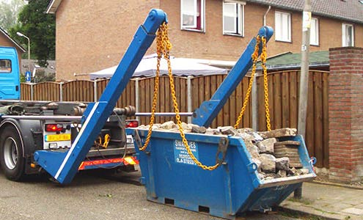
Challenge
The built environment accounts for about 50% of all materials extracted and one-third of waste in the EU
Notes:
CHARM relates to the challenge of reducing the environmental damage of our construction activities.
It is well known that the construction sector uses a lot of resources and causes a lot of pollution, both in terms of emissions as well as waste.
In the European Union, the built environment accounts for about 50% of all materials extracted and one-third of the waste that is generated.

Slide 4
Social Housing Organisations
Large portfolio’s
Professional management
Sustainability key value
Notes:
Social housing organisations are well placed to do something about this.
CLICK They operate large portfolios ranging from a few hundreds to tens of thousands of dwellings
Thus, they perform a lot of construction, renovation and maintenance activities.
CLICK Also, most of them have a professional management AND CLICK have sustainability as one of their key values. As such, they can make a substantial contribution to upscaling circular practices.

Slide 5
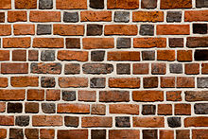
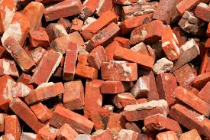
No More Downcycling!
Notes:
The main principle in CHARM is that we want to prevent downcycling of materials.
As this simple example shows, we do not want bricks to end up as gravel on the tennis court.
Although nice for tennis players, CLICK we want to reuse bricks at the same or even higher value level, for instance by re-using bricks from a demolition project in new or renovated housing.

Slide 6
Project Scope
Circular housing with re-use and for re-use
Digital and physical material exchange platforms
Demonstration exemplars of circular renovation and new construction
Notes:
The CHARM project has three main elements.
First we developed strategies for circular housing, focusing both on construction and renovation. These strategies enabled construction with re-use of materials as well as construction that enables future re-usability of building components.
Second, we developed material exchange platforms. These platforms enable circular flows of building materials and components when they reach their end of use. In one variant this is a physical storage place and in the other variant this is a digital exchange platform.
Third, we showcased circular approaches for both renovation and new construction in demonstration exemplars of our four social housing partner organisations.
We will now talk you briefly through these demonstration exemplars.

Slide 7
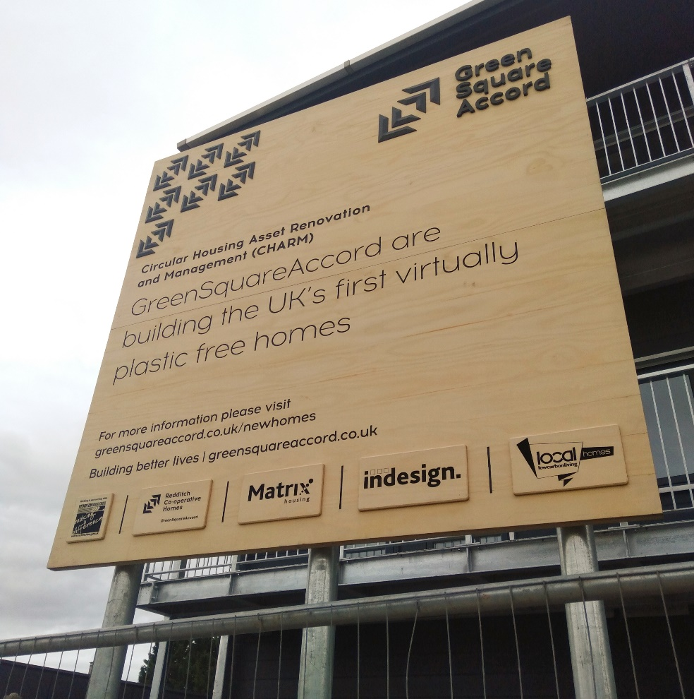
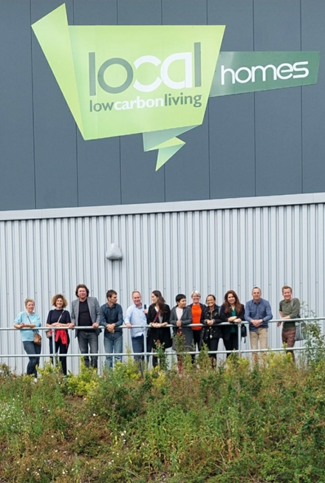
Plastic free house
Notes:
The first demonstration exemplar is the plastic free house developed by GreensquareAccord in the United Kingdom.
Polution from plastic ending up as particles in our land and water is a huge concern.
GreensquareAccord, therefore wanted to prevent this pollution by banning the use of plastics in housing altogether.
Moreover, they construct their social housing in their own factory– the LocalHomes factory.
These houses are easy to assemble and, if necessary in the far future, also easy to disassemble and reassemble.
And they use a timber frame construction method, which lowers the carbon footprint of the houses.

Slide 8
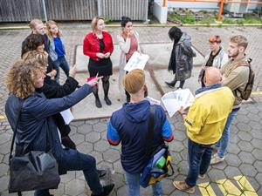
Design for re-use
Notes:
The second demonstration exemplar is from Woonbedrijf in the Netherlands. It focusses on designing houses that are fit for future re-useability.
Woonbedrijf designed a plan for modular temporary housing.
These houses were intended to be in use for about 15 years on a development location, after which they would be replaced by permanent housing and relocated to another location.
The plans were developed in a co-design process with the future tenants.

Slide 9
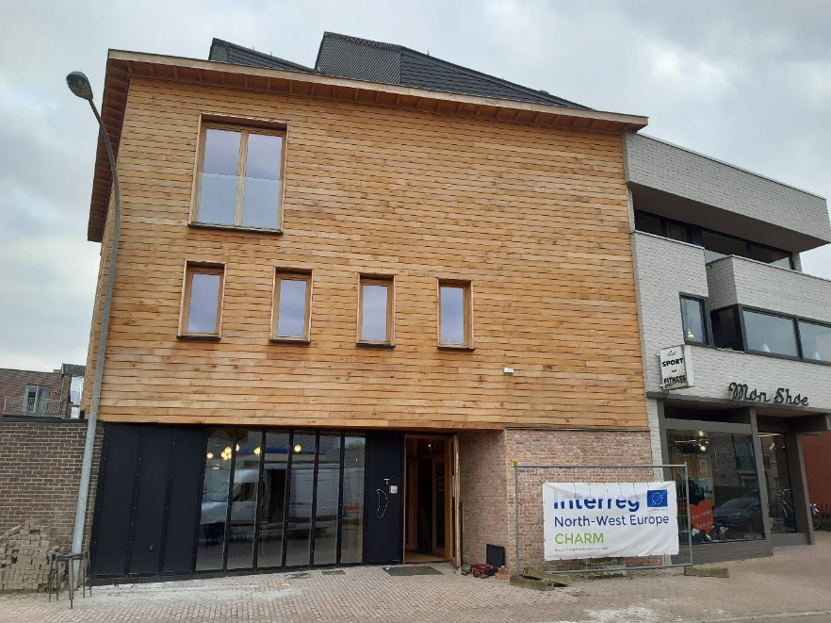
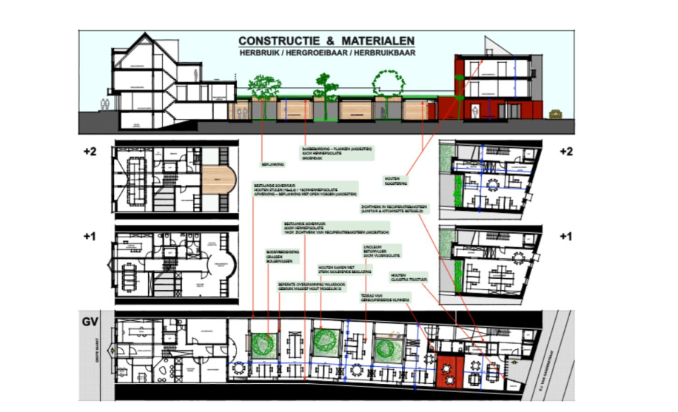
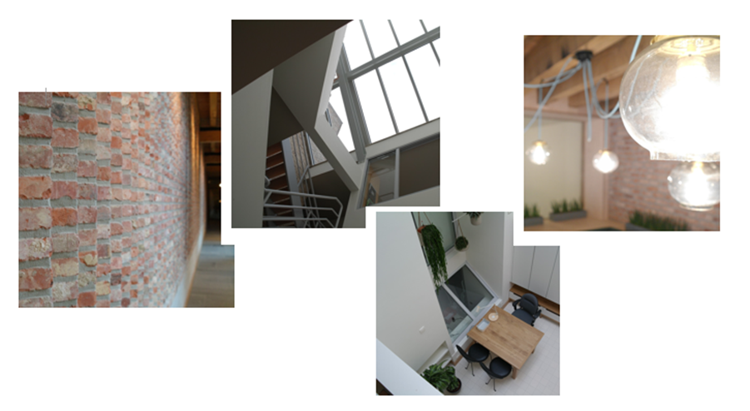
Construct with re-use
Notes:
The Flemish social housing organisation Zonnige Kempen, developed the third demonstration exemplar.
To show to their tenants what is possible in building with reclaimed materials, they built their own office with using second hand materials as much as possible.
They also included two social rented dwellings with reclaimed materials in this project and designed their office in a way that it can be easily adapted to housing for elderly in the future.

Slide 10
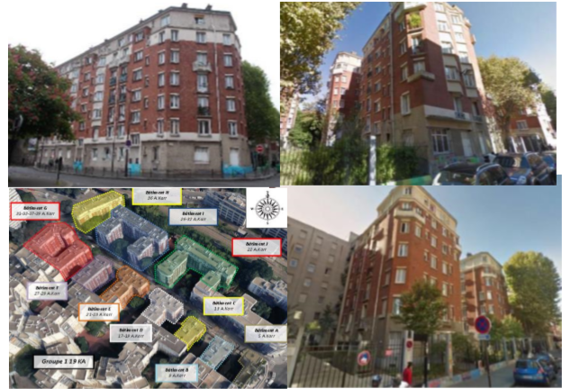
Renovate with re-use
Notes:
Paris Habitat, a large social housing organisation in France, has made renovation with reclaimed materials a key focus in their operations.
With the help of internal and external contractors and architects, they either refurbish components for re-use in their current function, or they use materials coming out of renovation projects to develop new components, such as kitchen cabinets made from old doors.
And when they upgrade a dwelling at turnover, before a new tenant comes in, they use reclaimed materials as much as possible.

Slide 11
Key Stakeholders
Key Activities
Profit
Customer Relationships
Customer segments
Value creation
Value propo-sition
Value delivery
Key Resources & Capabilities
People
Planet
Channels
Value capture
Cost structure
Revenue Streams
Sustainable business model canvas. Source: Bocken et al. (2018) based on Osterwalder &Pigneur (2010) and Richardson (2008)
Notes:
Now you know the basics of CHARM, it is time to continue with the rest of the tutorial.
In the following two recorded presentations we dive deeper into the approaches we developed.
In doing so, we follow the elements of the sustainable business model canvas.
For each of the approaches and tools applied in CHARM, we summarise what the value proposition is, how the value is created, how it is delivered to the users and how values are captured.
The second part of this online tutorial explains the sustainable business models for the demonstration exemplars. The third part focusses on the material exchange platforms.

Slide 12
ADD PARTNER LOGOS
Notes:
On behalf of all the partners, I wish you great pleasure with following the other two parts of the tutorial
And I hope that it will help you to contribute to circularity in the housing and construction sector yourself.
Thank you for watching this introduction!

