Slide 1
Using European partnerships to accelerate Marine Energy
November 5th 2021– Koen Donkers

Slide 2
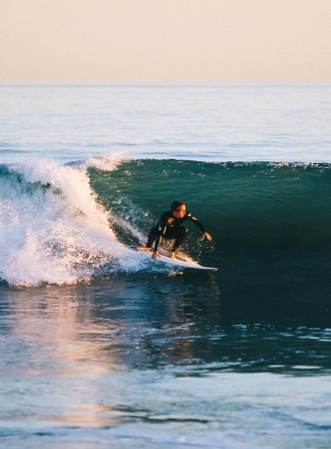
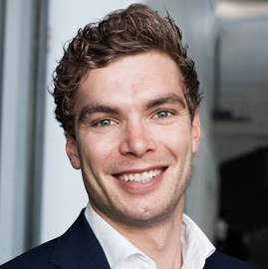
Dutch Marine Energy Centre (DMEC)
represented by
Koen Donkers
Business and Innovation Advisor
Koen@dutchmarineenergy.com
+31 6 40199888
Dedicated to making marine energy the next big thing in energy!

Slide 3
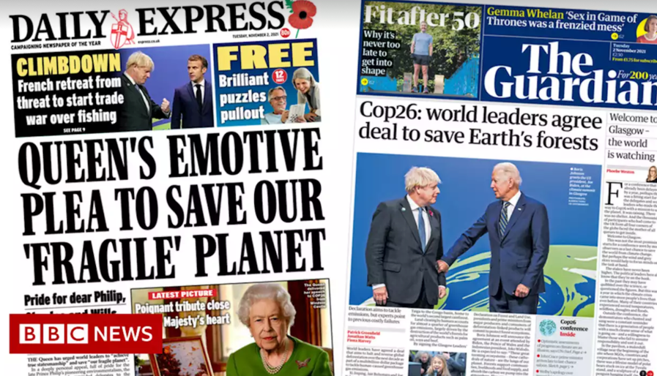
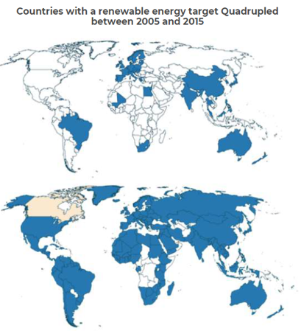
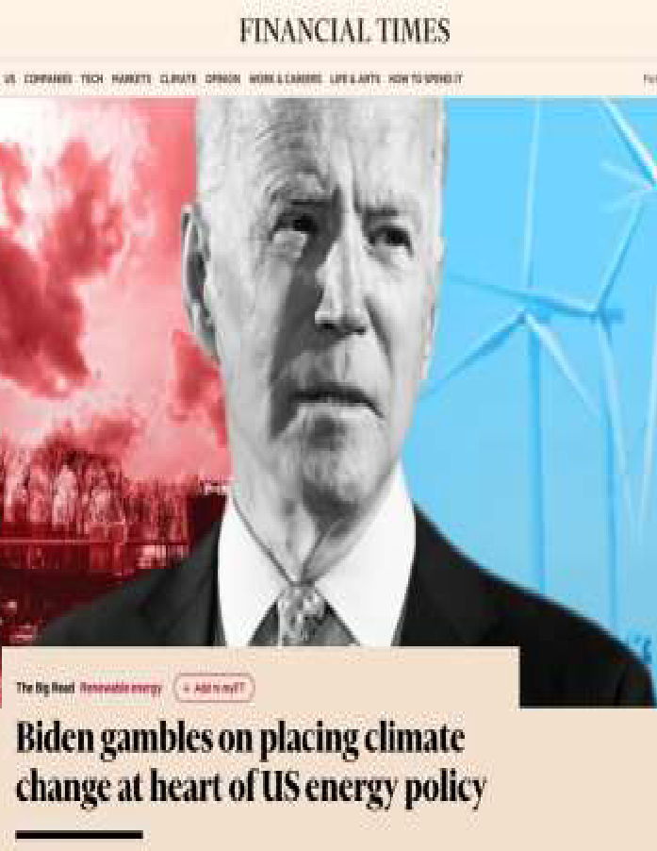
The transition to renewable energy is unstoppable...

Slide 4
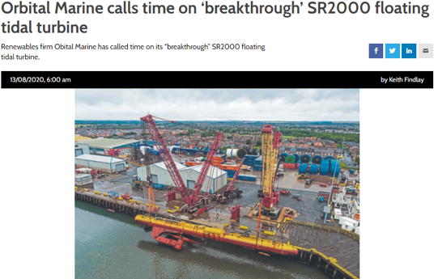
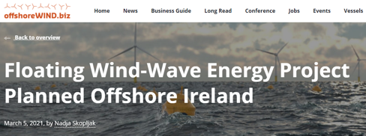
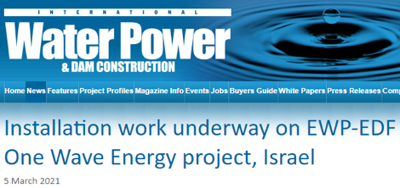
... and marine energy is a part of it

Slide 5
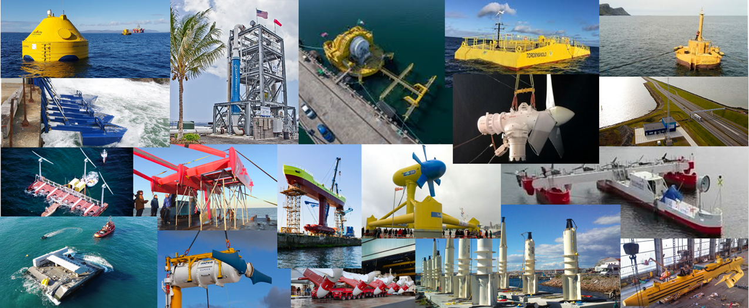
... with large scale devices

Slide 6
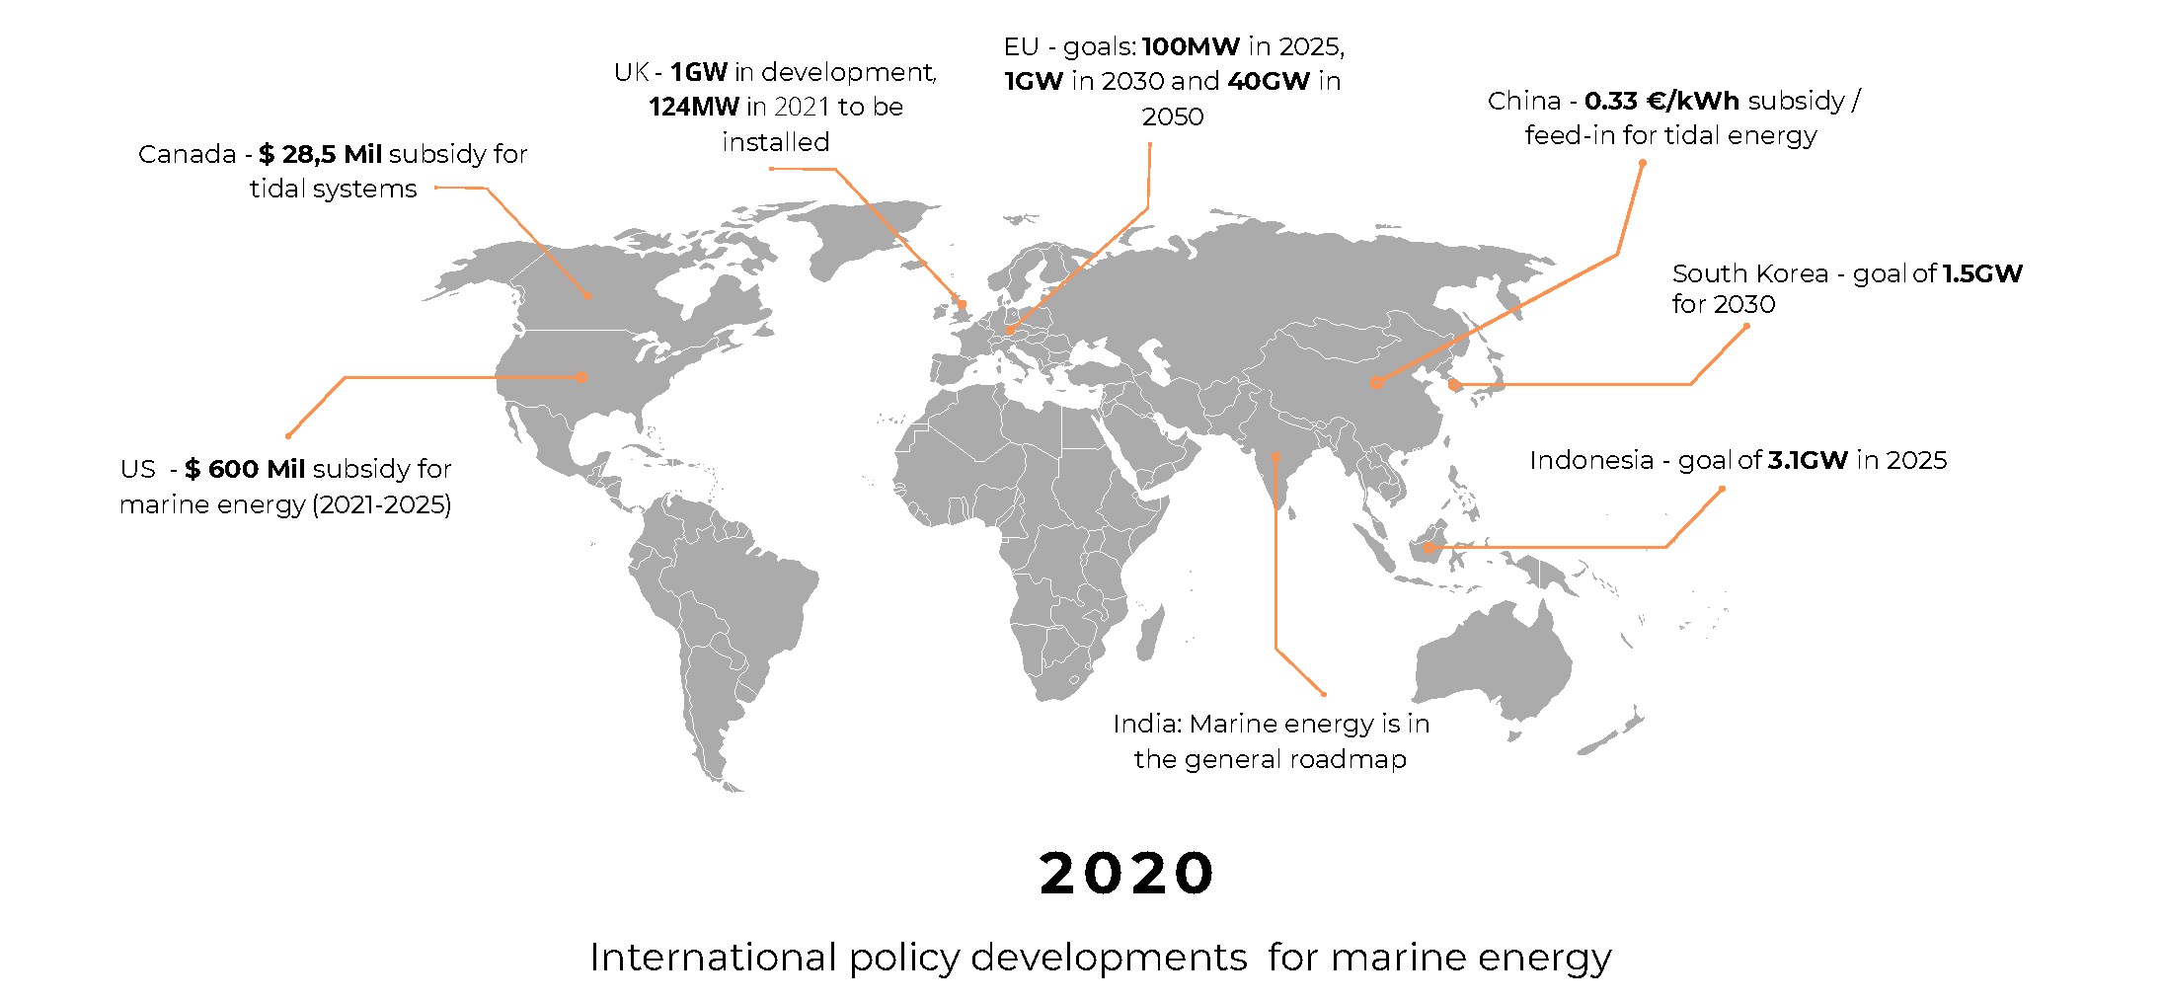
... supported by policy incentives

Slide 7
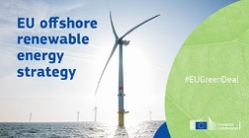
EU targets for marine energy
2021
2025
2030
2050
5,57
MW
100
MW
1000
MW
40.000
MW

Slide 8
Marine energy technologies
Wave Energy
Tidal Energy
Floating Solar Energy
Ocean Thermal Energy Conversion (OTEC)
Salinity Gradient Energy
Floating Wind Energy

Slide 9
Why marine energy?
Renewable
Reliable
Powerful
Invisible
Scalable

Slide 10
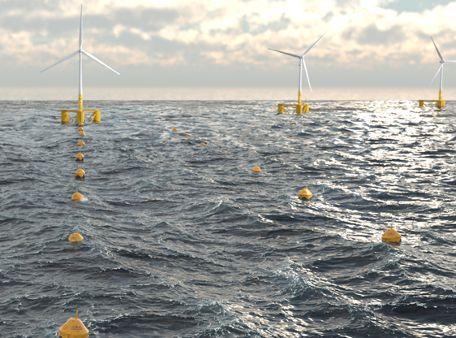
Important to a variety of markets
ENERGISE INFRASTRUCTURES
SUSTAIN OPERATIONS - PORTS
OFF-GRID SOLUTIONS
OFFSHORE MULTI-USE ENERGY FARMS
MARINE ENERGY FARMS
SUSTAIN OPERATIONS - PLATFORMS
COASTAL PROTECTION

Slide 11
DMEC an accelerator for marine energy
Innovation
Capital
Policy
Markets
Advance technologies and products
Mobilise investments
Shape policies
Commercialise solutions
>85
>125
€ 128 M
International Partners
Technology Companies
Public & Private Investments

Slide 12
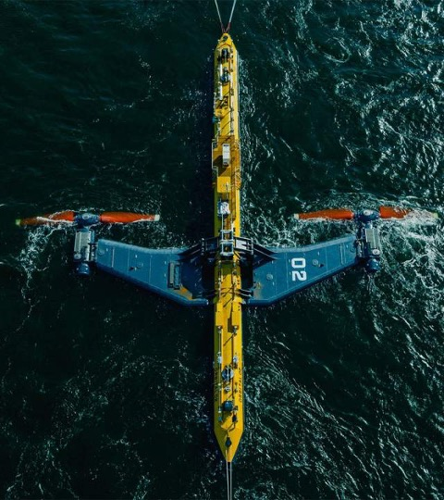
The sector needs partnerships
Share knowledge
Create shared vision
Convince policy makers

Slide 13
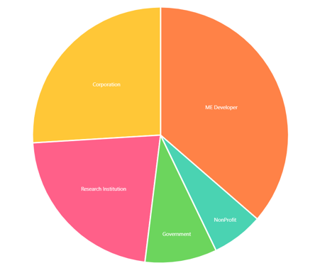
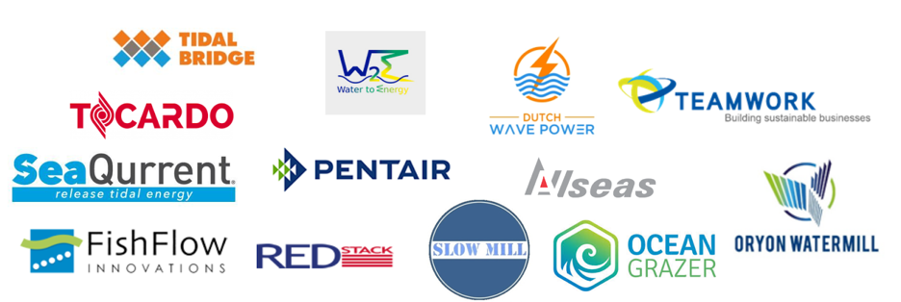
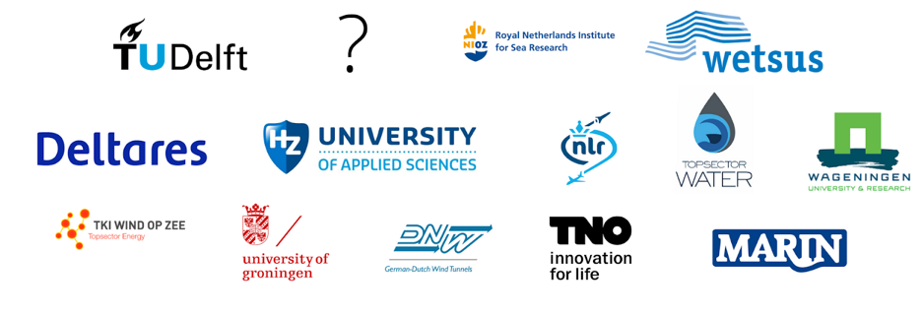
National..
>50 organizations
>100 individuals
>60 test facilities
Advisory board with
IRO (400 members),
NVDE (6000 members),
NWP (181 members)
and NWEA (300 members)
Corporations
Marine Energy developers
Research
Institutes
NonProfit
Govern-ment

Slide 14
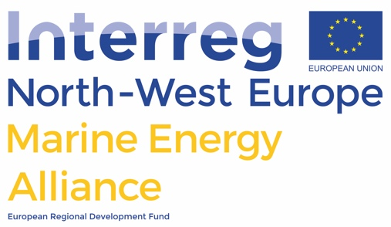
And European partnerships

Slide 15
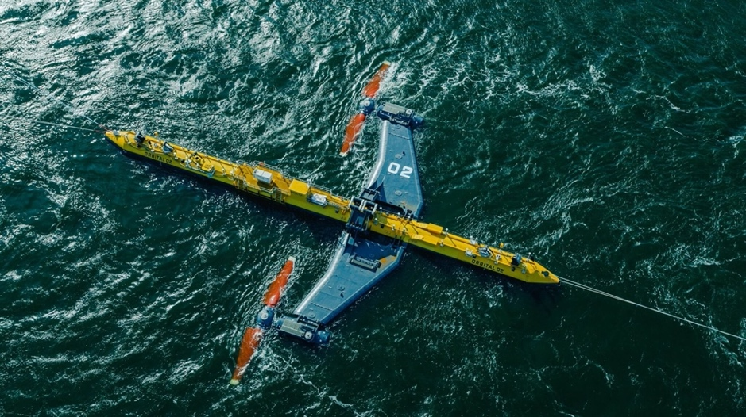
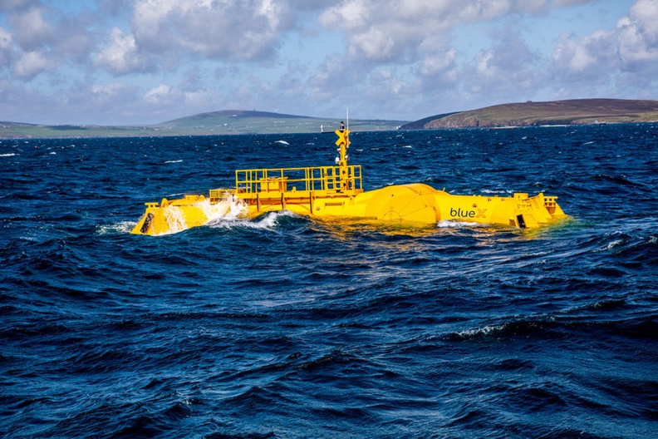
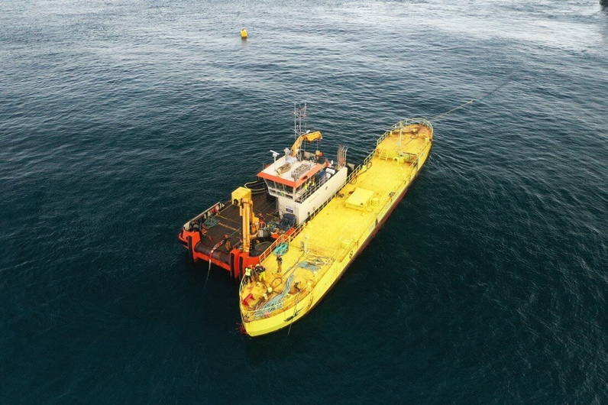
Orbital Marine Power
Magallanes Renovables
MOcean (BlueAxe)
2 MW 2021 EMEC
2 MW 2021 EMEC
0.01 MW 2021 EMEC

Slide 16
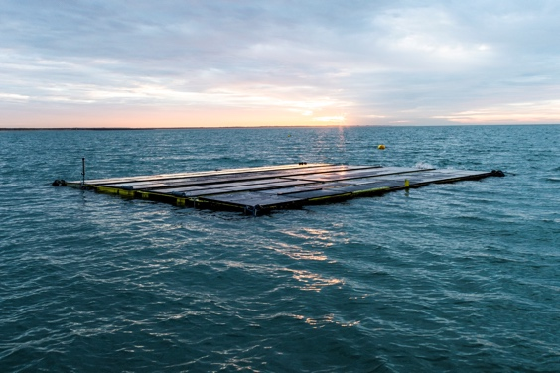
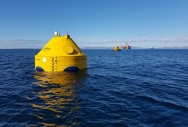
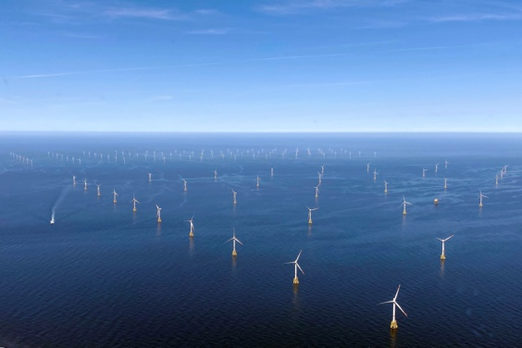
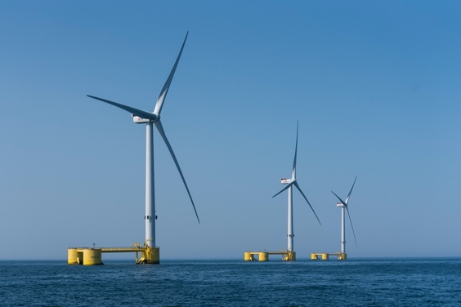
© Oceans of Energy
© CorPower Ocean
© RWE Renewables
© EDP Labelec
Enable the large-scale rollout of
offshore solar PV and wave energy converters
in offshore wind parks.

Slide 17
The reasoning: More cost- and space-efficient utilization of offshore area
Space reduction
Same…
Assists marine spatial planning
Source colocation
Substations
Cables
Cost reduction
Marine Space
Vessels
OPEX & CAPEX

Slide 18
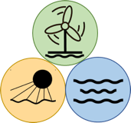
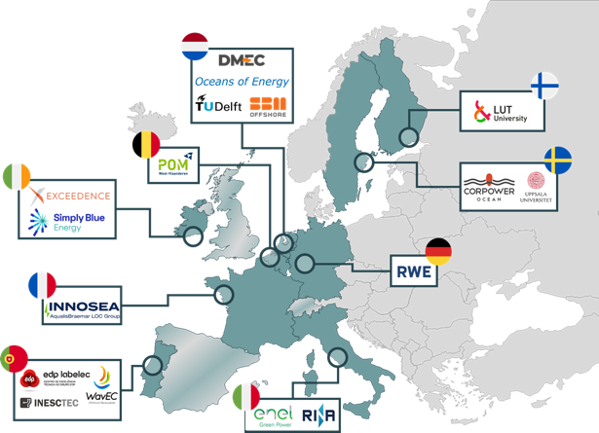
The consortium
Consisting of …
12 European countries
17 partners (on the right) & 7 associated partners
8 scale-up advisors (ENECO, ENBW, PW, OceanWinds, OEE, TenneT, REN, IRO)
… and coordinated by DMEC

Slide 19
DMEC’s project portfolio in 2021
CONCEPT
PROTOTYPE
DEMONSTRATION
COMMERCIAL
SOLUTION
Project focus
Technical & business support services:
Marine Energy Alliance
Ocean Energy Scale-up Alliance
Standardization and certification:
ENCORE
MET-Certified
Access
to test facilities & open water testing:
MARINET 2
FORESEA
Ocean DEMO
Large-scale test of multi-use:
EU-SCORES
Cross-sectoral collaboration:
Ocean Power Innovation Network

Slide 20
So..
Collaboration is key
To make marine energy the next big thing in energy!

Slide 21
Thank you

