Slide 1
Webinar
How to plan your eHUB?

Slide 2
Webinar: How to plan your eHUB?
Jasper Meekes
Policy advisor on Mobility, Nijmegen Municipality
15 December 2020

Slide 3

eHUBS Nijmegen/Arnhem
Goal of stimulating shared mobility
Reduction of CO2 emission from traffic
Persuading car owners to get rid of (2nd) car

Slide 4
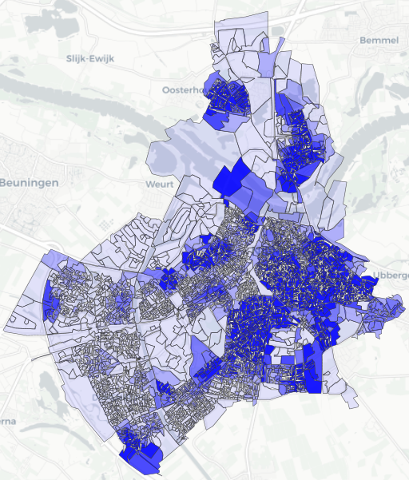
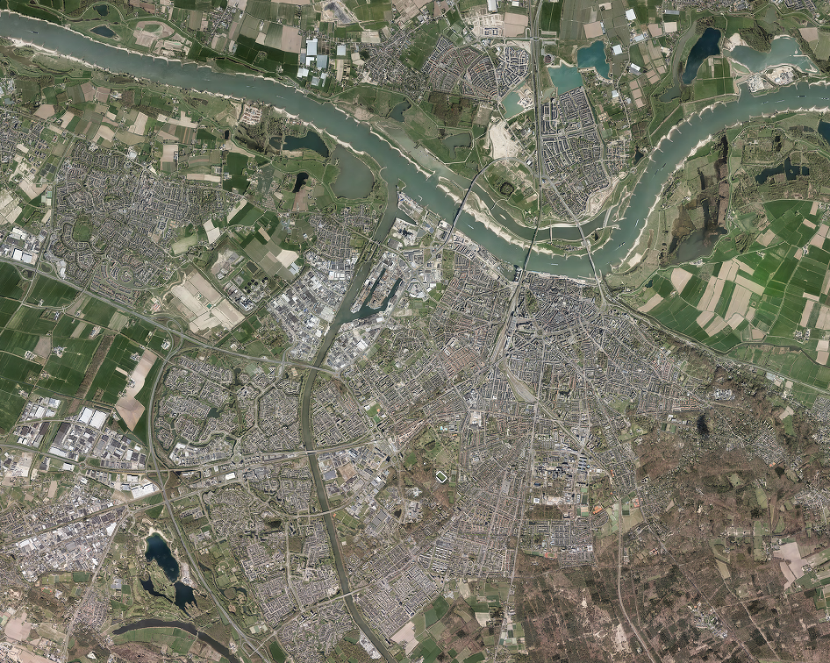


Location determination
Mix of top-down and bottom-up methods
Combining market demand and policy goals
Pragmatic approach to final location
  Availability of public space
  On site traffic
  Local initiative

Slide 5
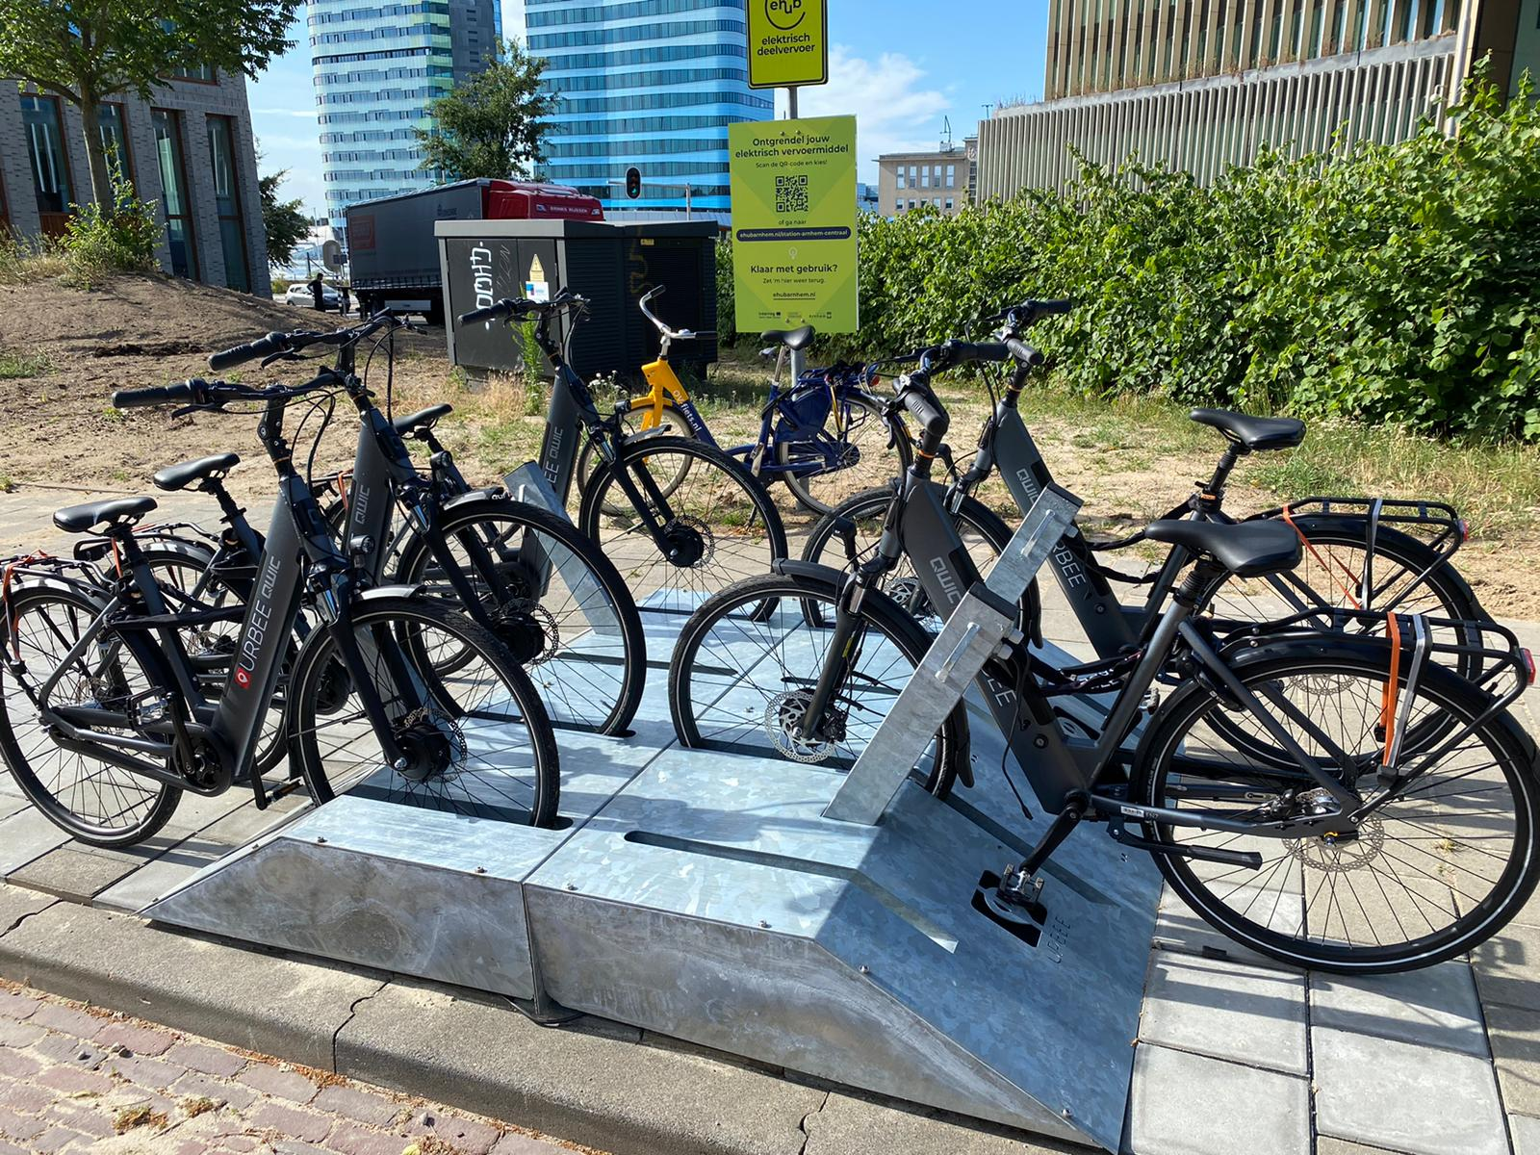
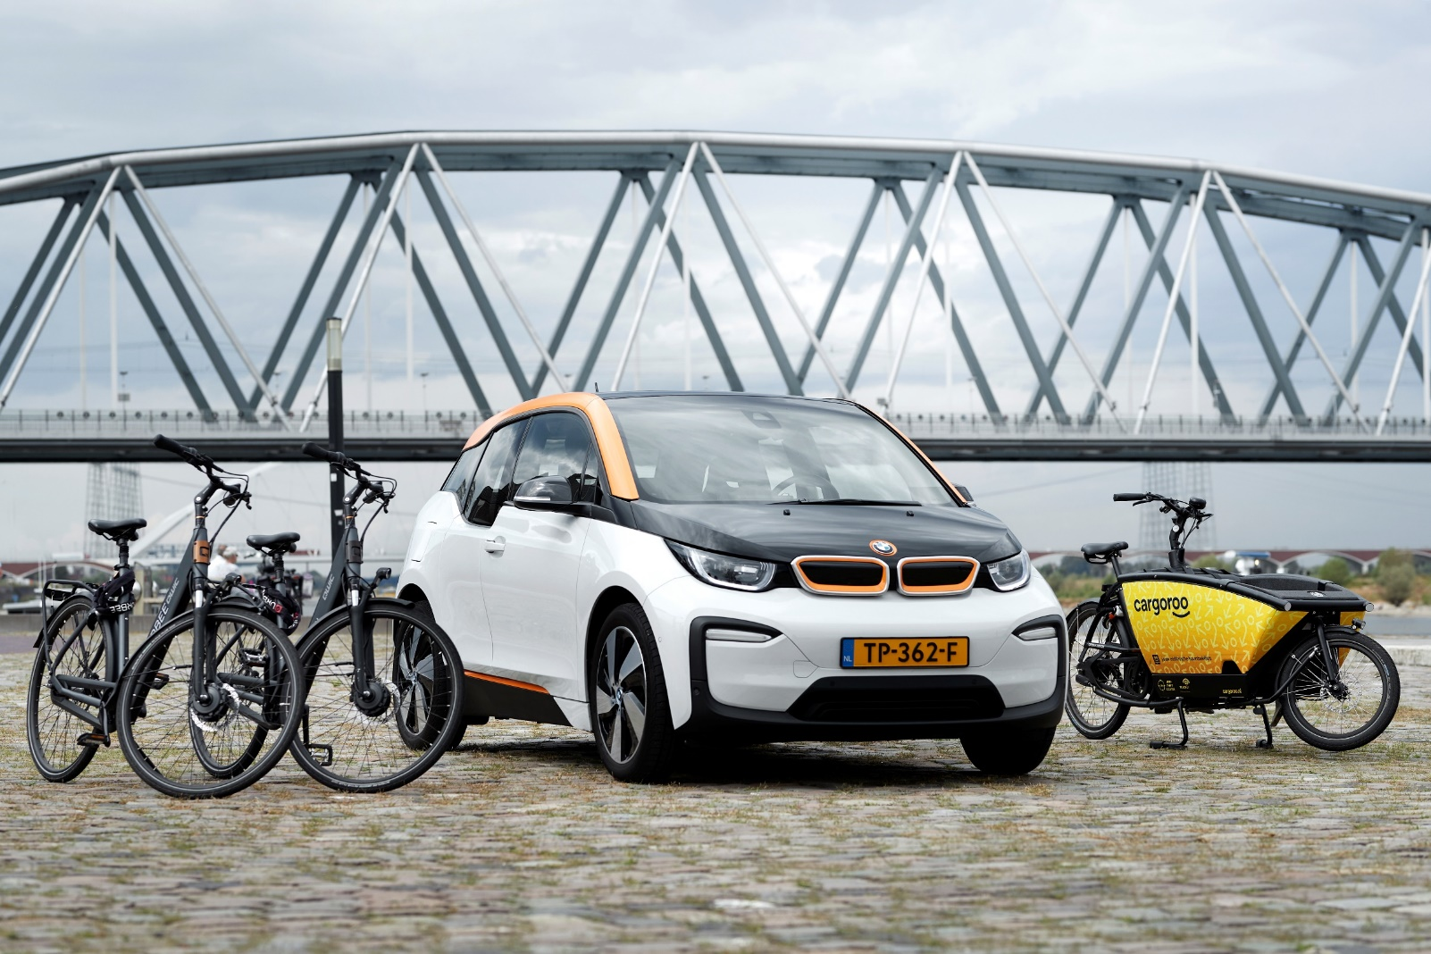
eHUB facilities
Pilot project – flexibility is key
  Permit-free
Battery swap for (cargo)bikes
Using existing car charging infrastructure where possible
Start with set number/types of vehicles
Monitor and adapt to actual usage

Slide 6
eHUB usage
Communication is key
  Marketing strategy developed
  Brand deployment
Behavioral change
  New interventions planned
  Initial focus on using eHUBS
  Secondary focus on getting people out of (own) car

Slide 9
Thank you for your attention!
j.meekes@nijmegen.nl

