Slide 1
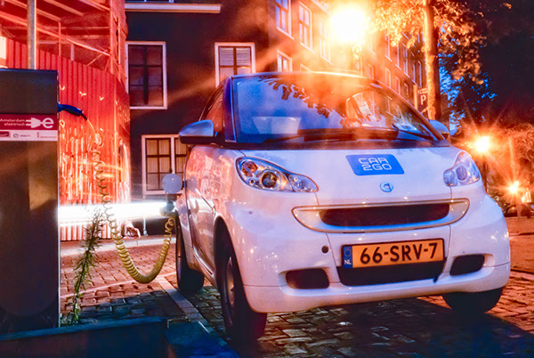
Heatmaps indicating the relative potential for eHUBS
Dr. ir. Fanchao Liao
Dr. ir. Gonçalo Homem de Almeida Correia
(Delft University of Technology,
Department of Transport & Planning)

Slide 2
Heatmaps indicating potential for eHUBS
We characterize the relative potential for eHUBS in each zone via the so-called “”heatmaps”. The map shows the relative level of potential demand for shared e-mobility per zone. There are three maps for each city, each respectively shows the potential for shared electric vehicle, shared e-bike and eHUBS in general (both shared EV and e-bike). The maps use color coding: the darker the color, the greater the potential demand in that specific zone.

Slide 3
Methods for deriving the indicators
Information input:
Data on socio-demographics, transport connectivity, land use and Point of Interest (POI)
Spatial Multi-Criteria Evaluation (SMCE)
Statistical model: taken from published studies based on real transaction records of existing shared e-bike and EV systems
Outputs: Indicator of potential for eHUBS and heatmap

Slide 4
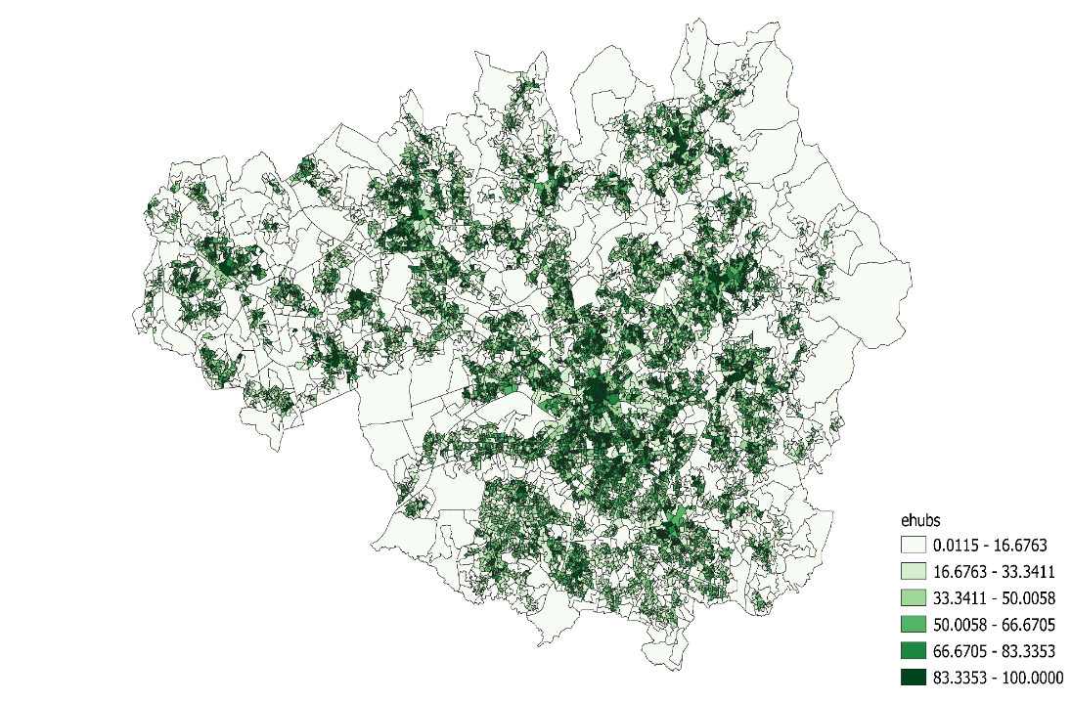
In the heatmap, the indicator denotes the percentage rank of a zone in terms of shared e-mobility potential. For example, indicates that shared mobility potential of the zones with this color are in the 83.3353-100 percentile (in other words, the potential of these zones is higher than 83.3353-100 percent of the zones).

